Slide 1
COURSEWORK TOPICS

Slide 2
LOCKDOWN INFO – Y11 PHOTOGRAPY
If we go into another lockdown situation then you should continue to work on your ‘Coursework’ PowerPoint and build up the slides in order
View the teacher PowerPoint and work out where you have got to – complete any outstanding bits needed for the particular section you were last working on in school.
Move to the next section of work – paying close attention to the order the work should come in – this can be found towards the end of the PowerPoint. ACTION PLAN
Take care and time when taking photoshoots and save all images into individual folders to keep safe. DO NOT LOOSE YOUR WORK – SAVE ON A MEMORY STICK
A student example PowerPoint will also be available for you to view, which will help you with the slide layout BUT please do not simply copy!
If you are unsure at any stage about the section you are working on, then feel free to move on to the next section and make sure to make a note of any sections you have missed – You can then receive help on any missed sections on return to school
THE MOST IMPORTANT THING IS TO SPEND AT LEAST 3 HOURS A WEEK WORKING ON YOUR PHOTOGRAPHY GCSE COURSEWORK POWERPOINT
Feel free to email me for any further clarification – jdawson@farmors.gloucs.sch.uk

Slide 3
Choose ONE topic to work from as a major coursework piece with a minimum of 6 photo shoots…
Framing
OR
Light and Dark

Slide 4
Framing
BRIEF
Photographers sometimes use parts of their image as a technique for framing and so direct attention to a particular part of the picture. Photographs by Christopher Anderson, Henri Cartier-Bresson and Alex Webb show how doorways, windows, mirrors or gaps in walls can be used to frame a subject. Irving Penn sometimes used corners to direct attention towards his subject and Laura Letinsky often uses the edges of tables to frame her still life arrangements.
Take a series of photo shoots exploring ‘Framing’ and use the work of other photographers to help inspire your own final outcome.

Slide 5
Light and Dark
BRIEF
Willy Ronis and Horst P Horst often used back lighting to create a silhouette or tonal contrast between subject and background. Ferdinando Scianna and Alexey Bednij have used shadows to create contrast and pattern in their photographs. Marks and Spencer’s advertising campaign for promoting their food products uses the intense colour of ingredients contrasted against dark backgrounds.
Research appropriate sources and create a series of photo shoots and final outcome based on ‘Light and Dark’.

Slide 6
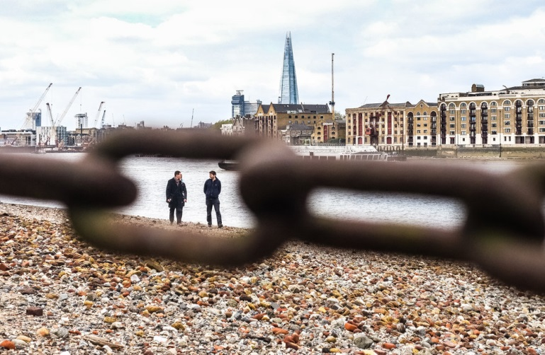
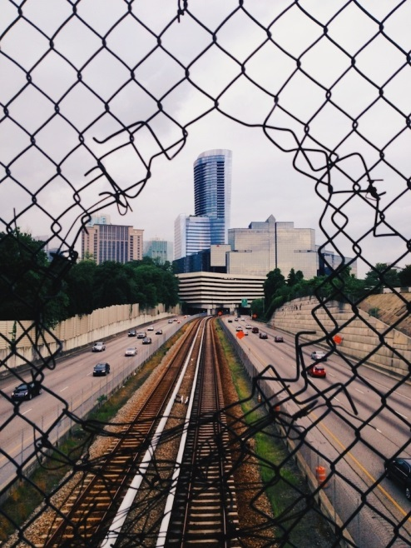
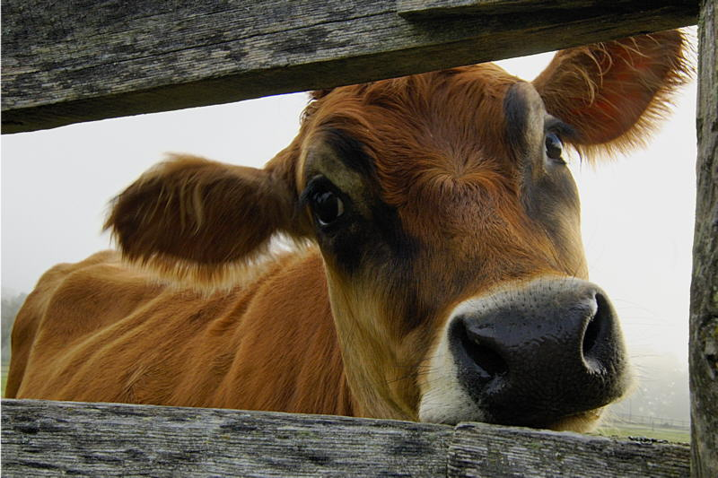
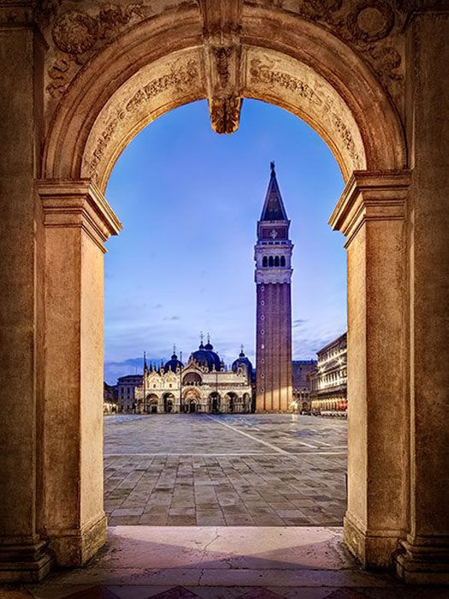
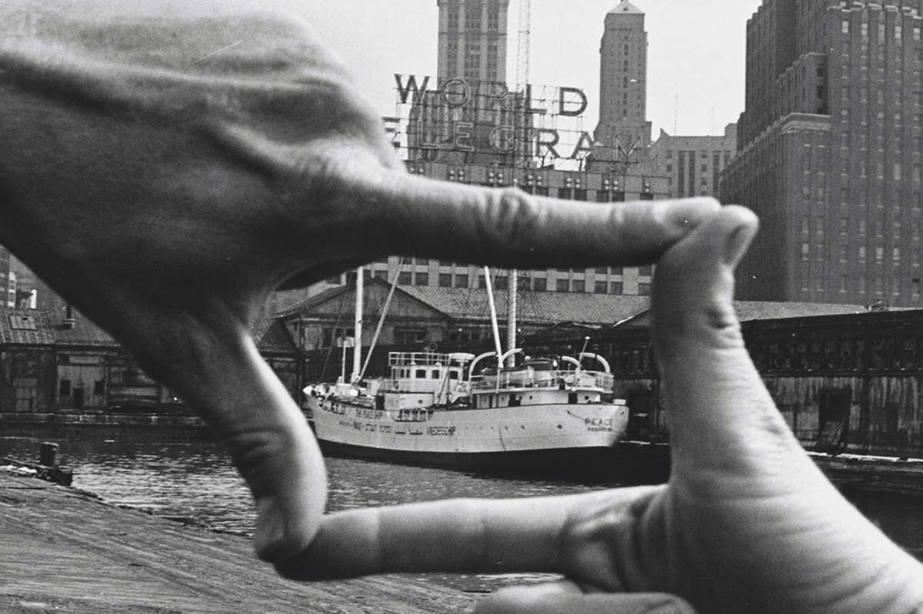
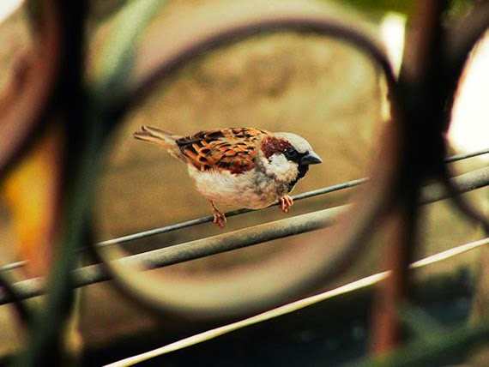
Framing

Slide 7
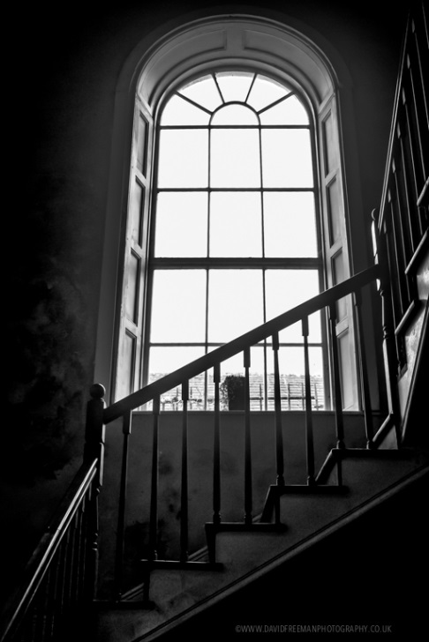
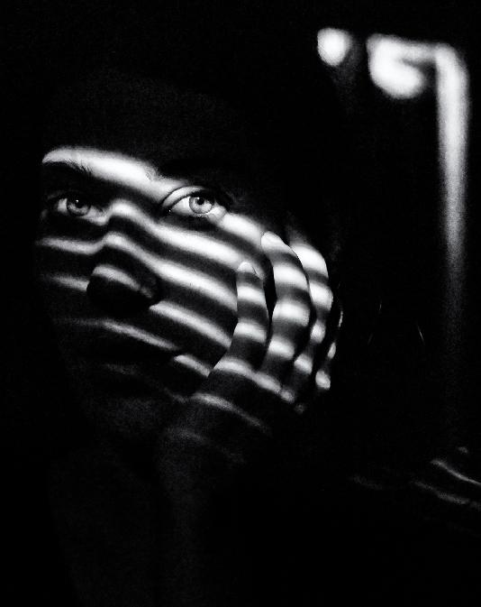
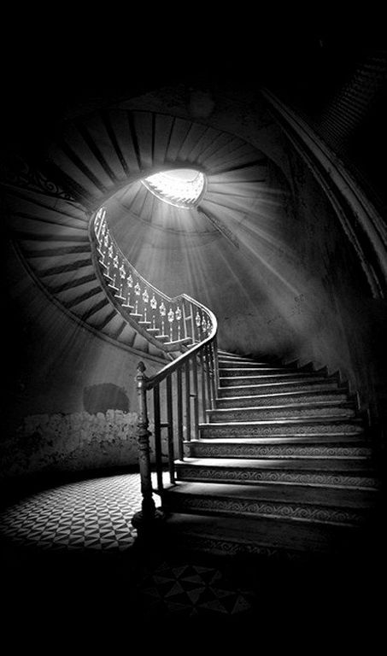
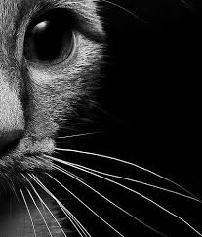
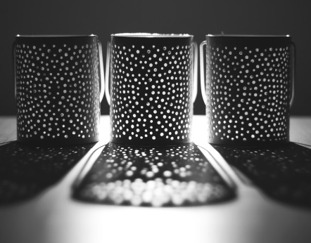
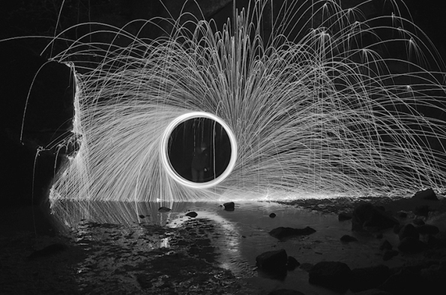
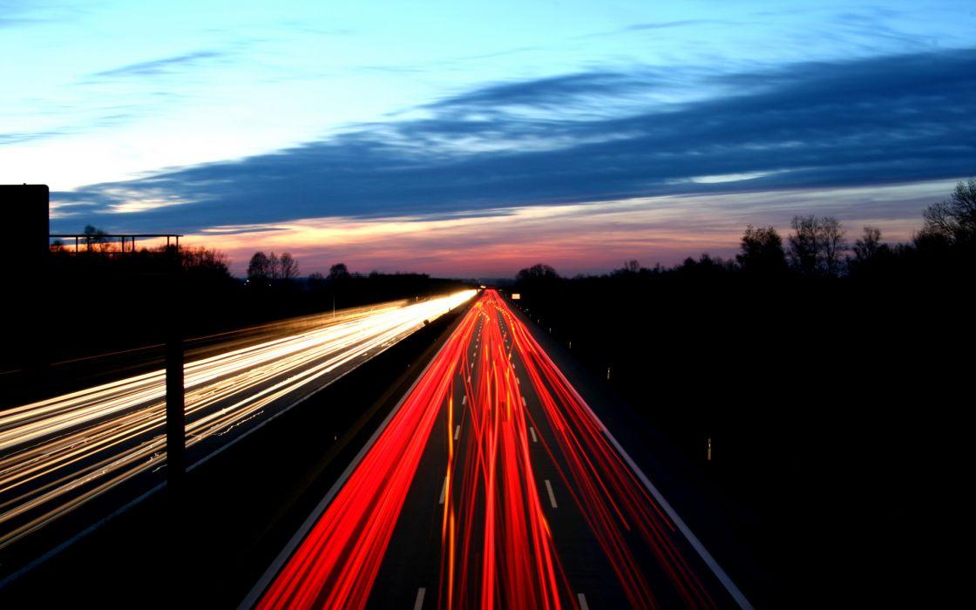
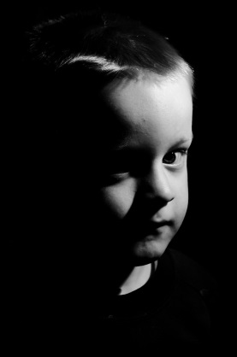
Light and Dark

Slide 8
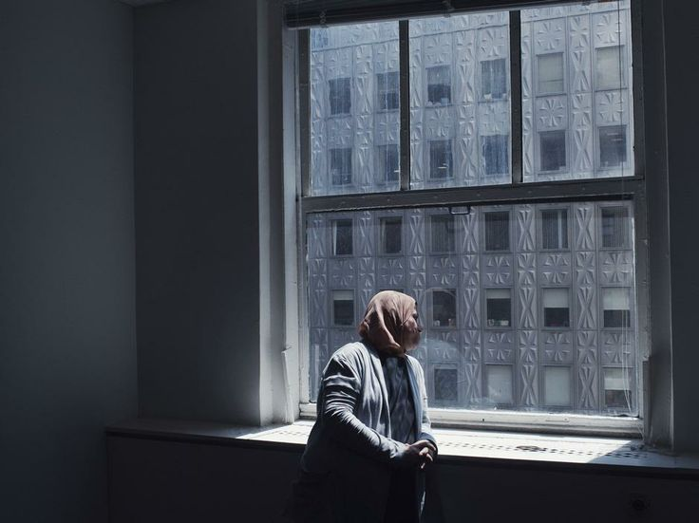
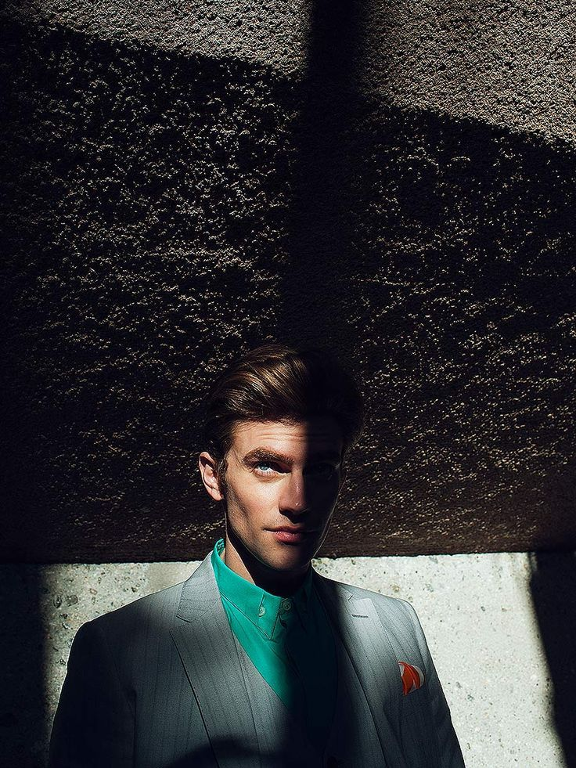
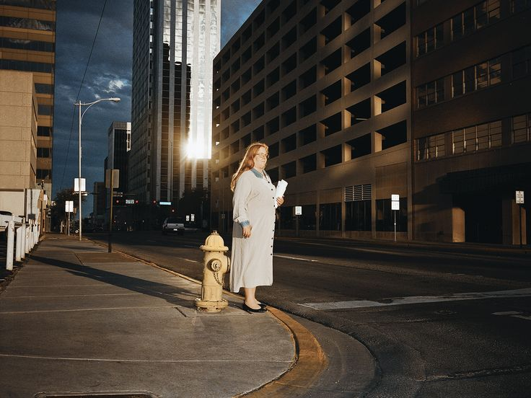
Framing – Christopher Anderson

Slide 9
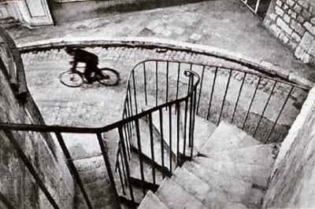
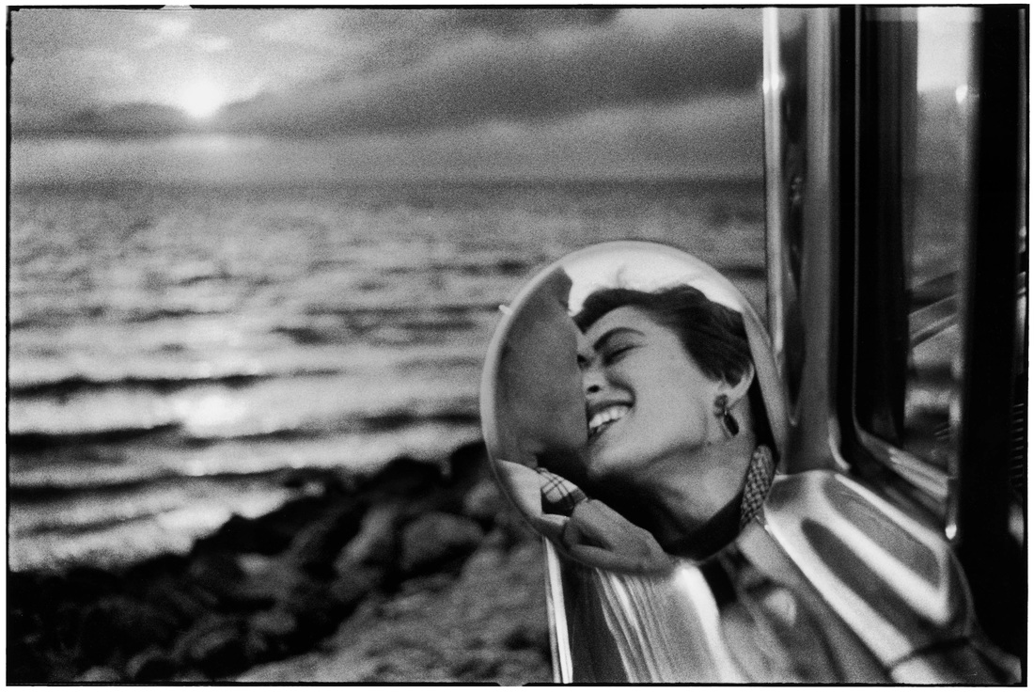
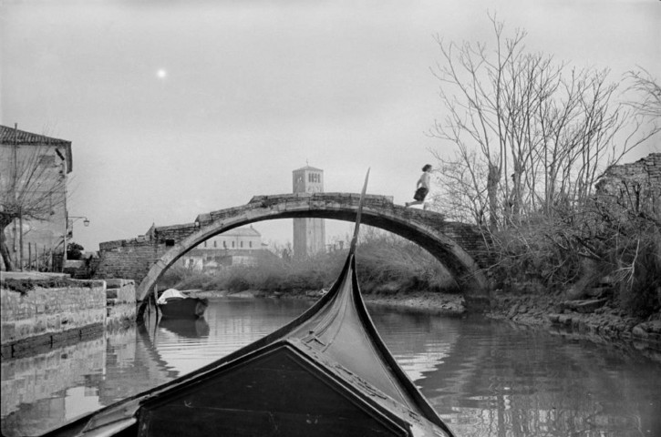
Framing – Henri Cartier-Bresson

Slide 10
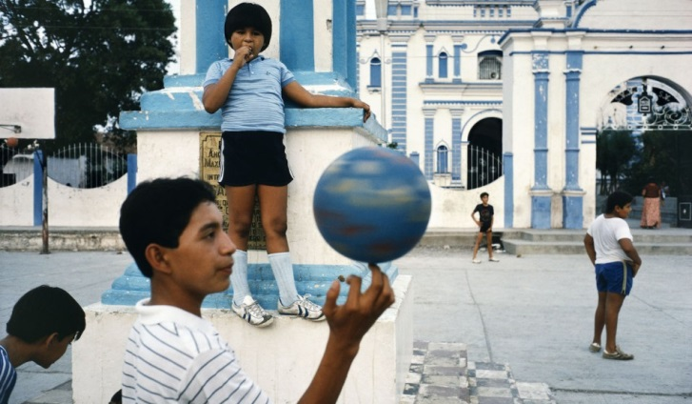
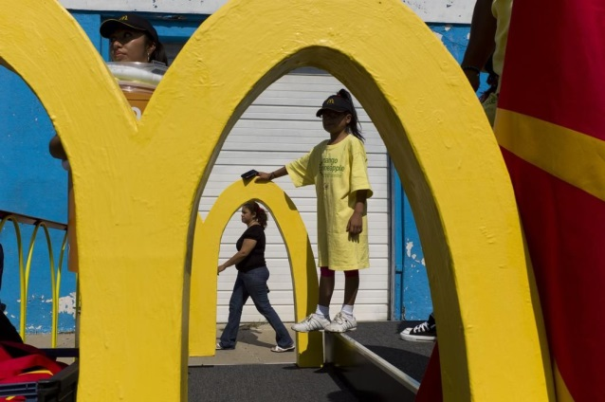
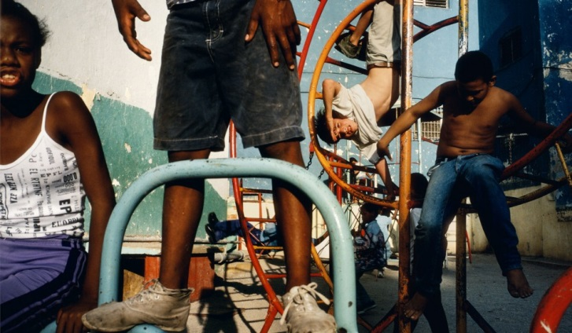
Framing – Alex Webb

Slide 11
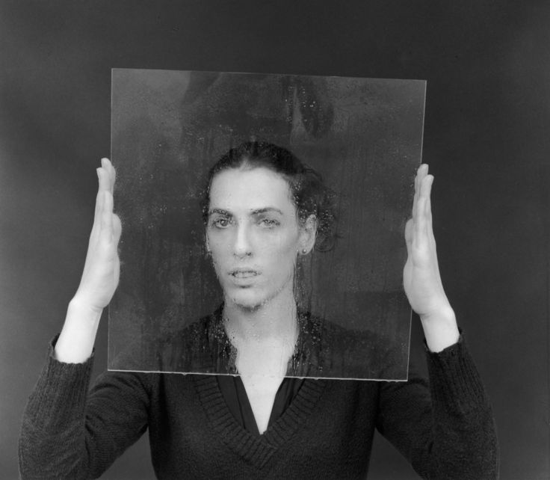
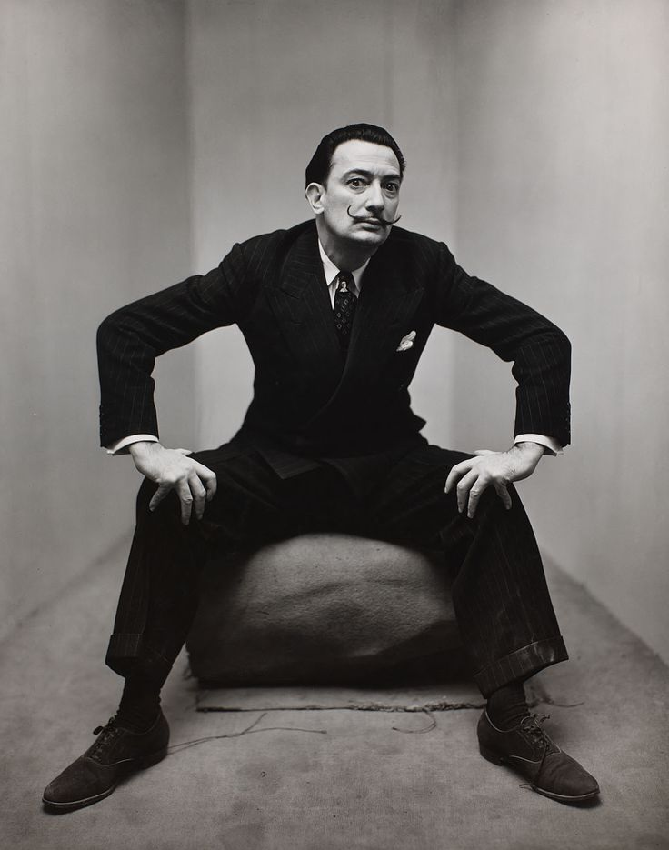
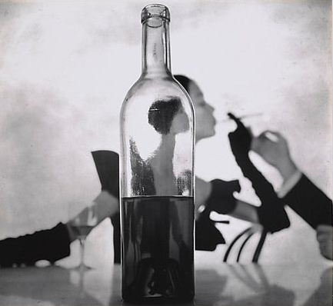
Framing – Irving Penn

Slide 12
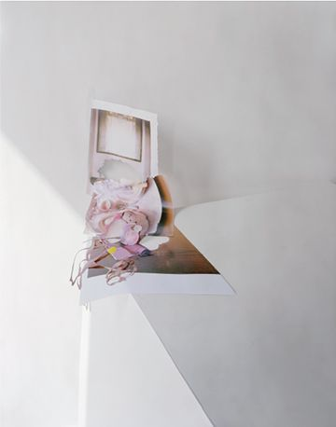
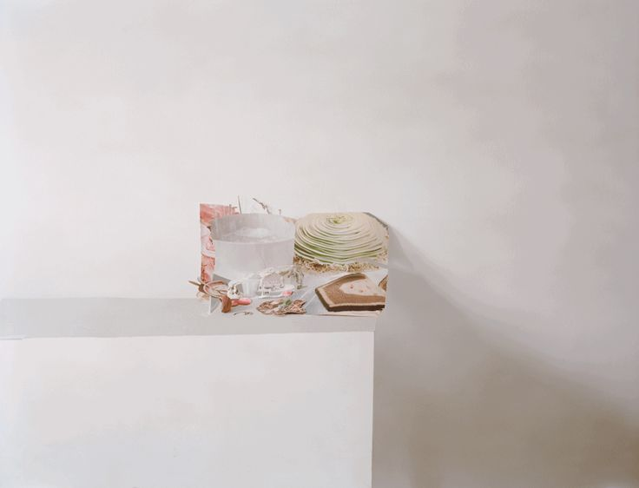
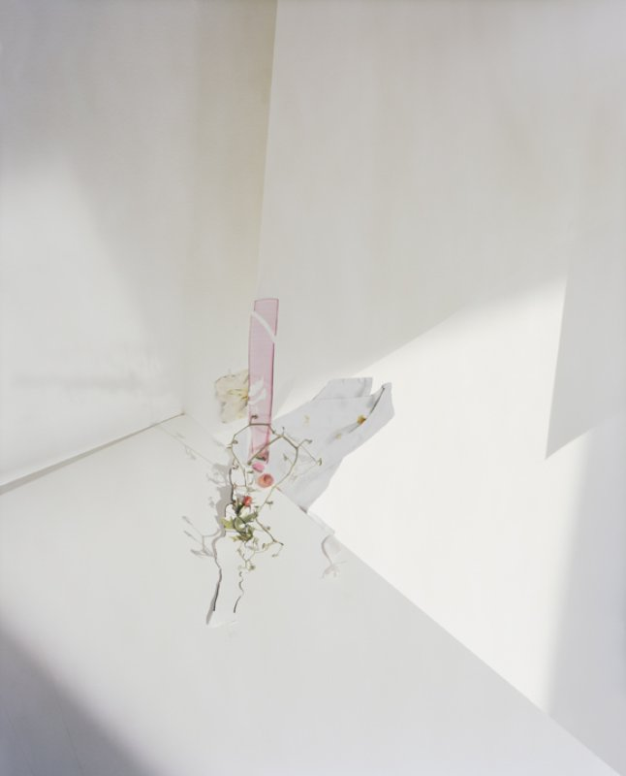
Framing – Laura Letinsky

Slide 13
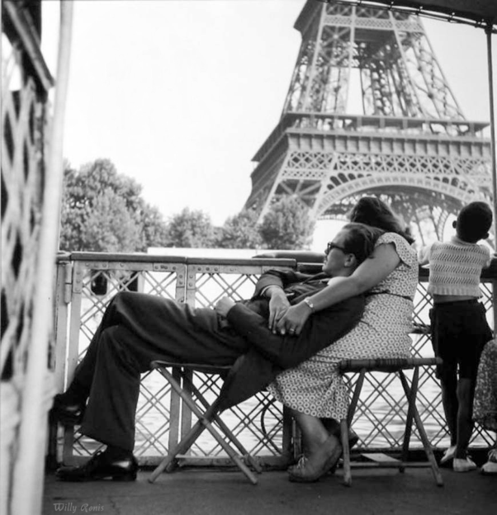
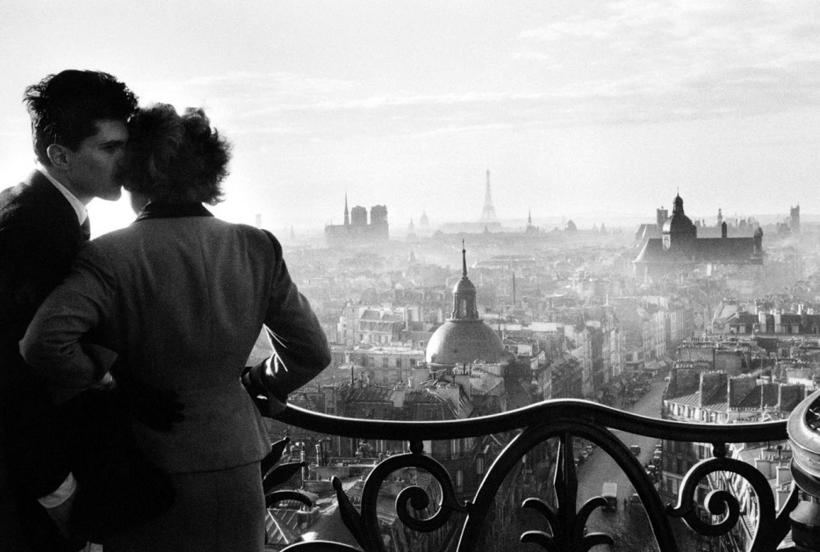
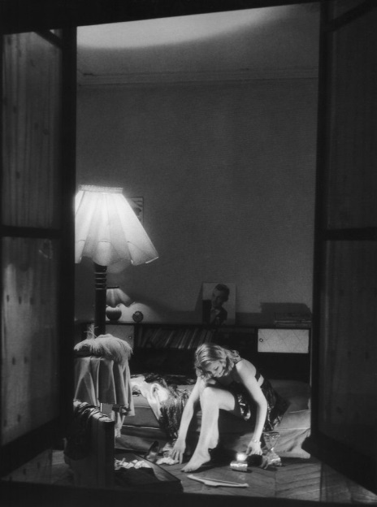
Light & Dark – Willy Ronis

Slide 14
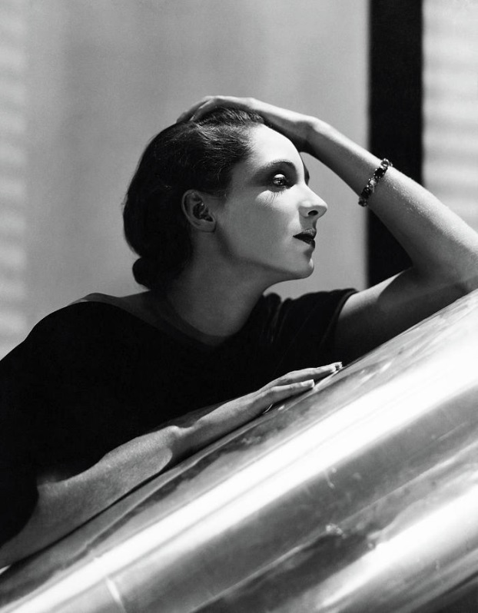
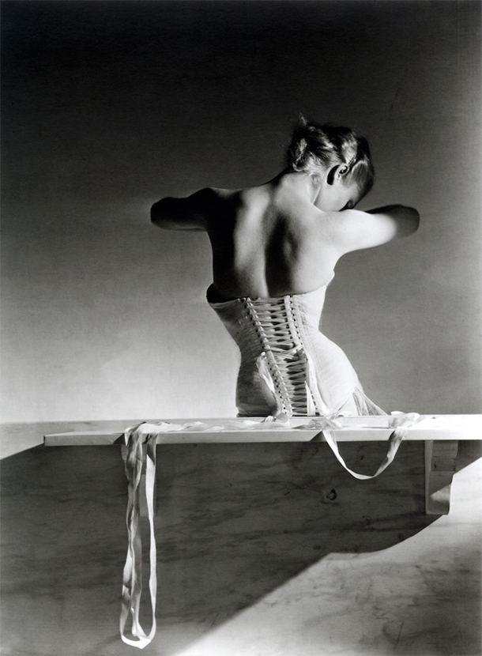
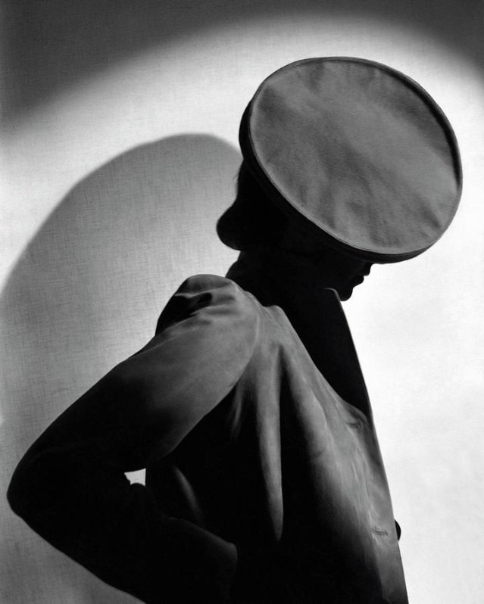
Light & Dark – Horst P Horst

Slide 15
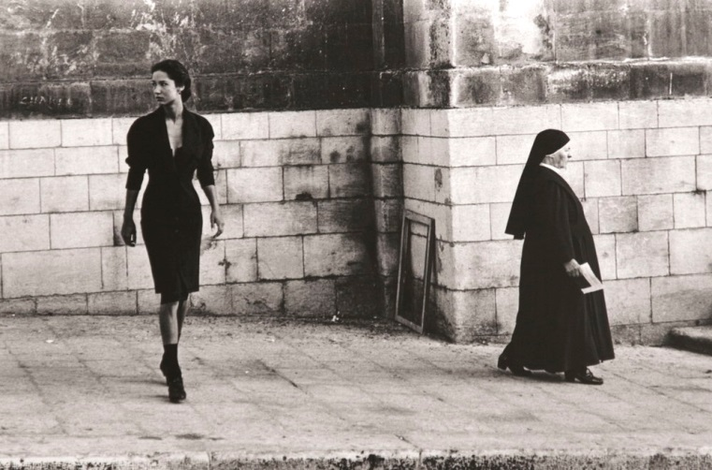
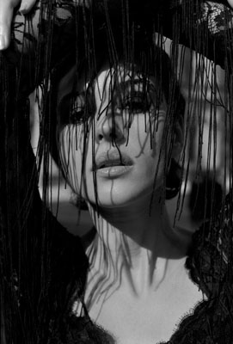
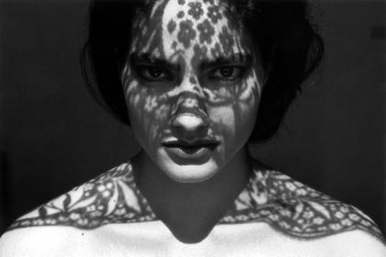
Light & Dark – Ferdinando Scianna

Slide 16
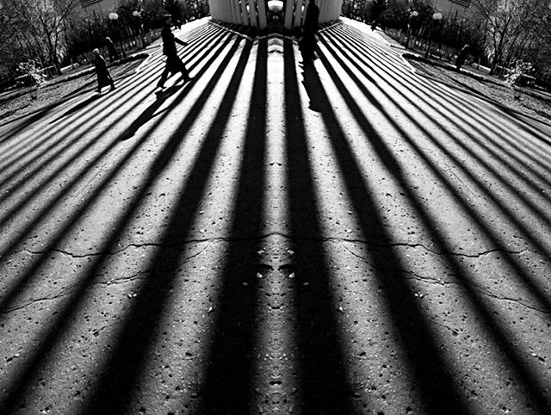
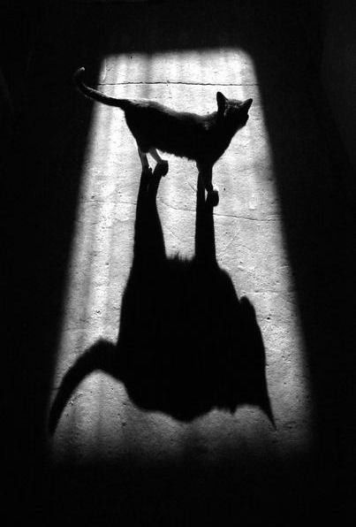
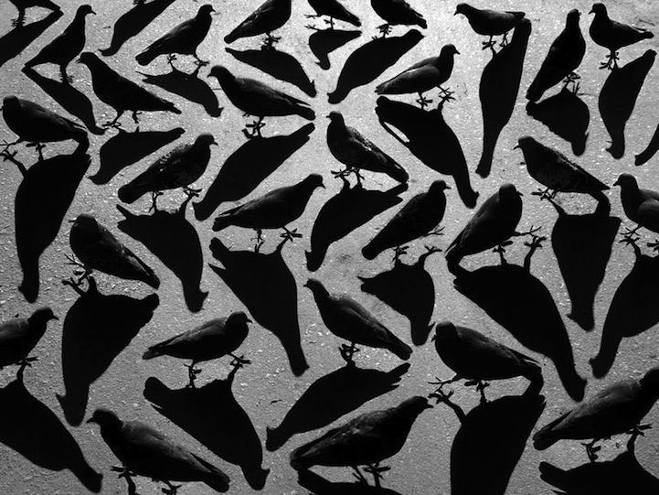
Light & Dark – Alexey Bednij

Slide 17
ACTION PLAN
Start a new PowerPoint dedicated to COURSEWORK
Choose either Framing OR Light and Dark as your coursework topic
Do a title page for your chosen topic – Add images & your name & candidate number
Do a Brief page for your chosen topic – This can be copied across from my PP
Write a Statement of Intent for your chosen topic. Write how you will answer the brief set? What will you take photos of? Where will you go (location(s)), props, models, lighting, camera skills/techniques used etc… LOOK AT EXAMPLE PP TO HELP YOU HERE…
Do an ideas page. This can be a spider diagram with notes
Do a inspirational images/mood board for the chosen topic
Photographer research – Work from the photographers issued in the brief and do a page for 2/3 photographers
Test Shoot. Take a test shoot for the chosen topic of 25 photos. Evaluate how the shoot went and shown 2 best images larger
Plan the shoots – Do a gridded plan for the shoots 1 to 4 (I will show you how to do this OR see example PP)
Shoot One with evaluation notes and 2 best images (50 plus photos)
Shoot Two with evaluation notes and 2 best images (50 plus photos)
Add in a further inspirational photographer or artist here and evaluate what you have done to date
Shoot Three with evaluation notes and 2 best images (50 plus photos)
Shoot Four with evaluation notes and 2 best images (50 plus photos) –
Further ideas – What have you done so far – do a quick summary – then state how you plan to move forward
Shoot Five/Six with evaluations

Slide 18
- Do a detailed analysis of one of your photographs (Use the 5 C’s worksheet)
Do several PC edits on a selection of best images (no less than 4 images) and write about how you edited the image and ideally show before and after
Show possible final outcomes (how could you produced an outcome?)
Produce a Final Piece (We will print this out and frame etc…
Evaluate how your major coursework topic has gone (I will give you a writing frame to help you with this)
COMPLETE

