Slide 1
This set of work in split into 3 categories; Line Colour Texture Please spend 1 hour on the Title page Please spend 3 hours per category – therefore this set of work will last nearly THREE WEEKS

Slide 2
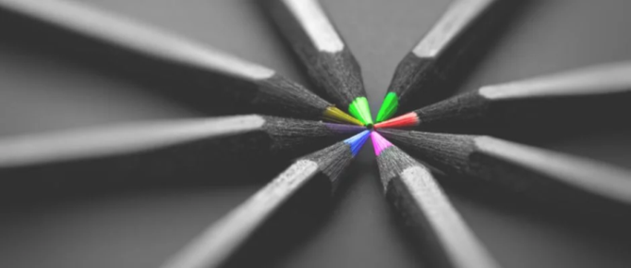
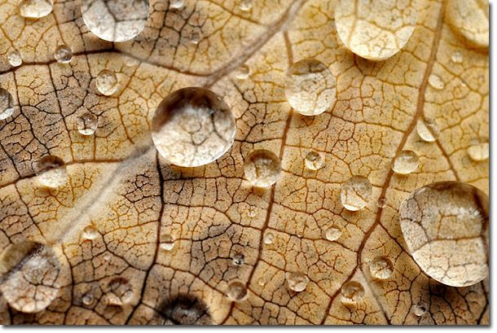
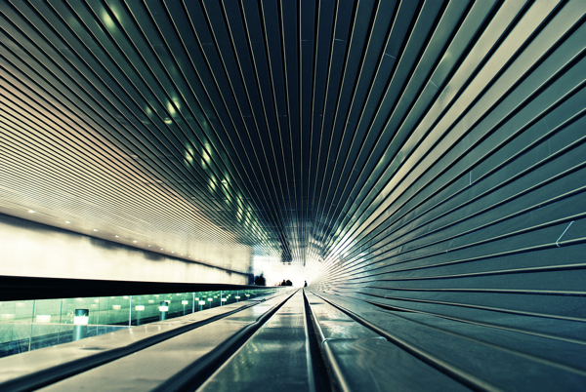
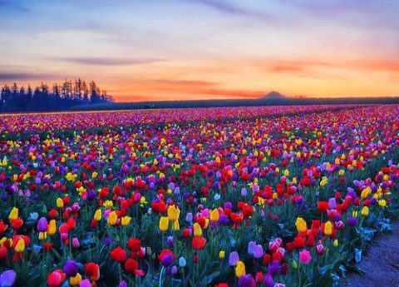
Visual Elements
Brief:
Take between 15-25 images for each of the 3 Visual Elements we are going to explore. Do a contact sheet for each and traffic light system as shown on the next slide.
Texture
Colour
Line
Texture
Line
Colour

Slide 3
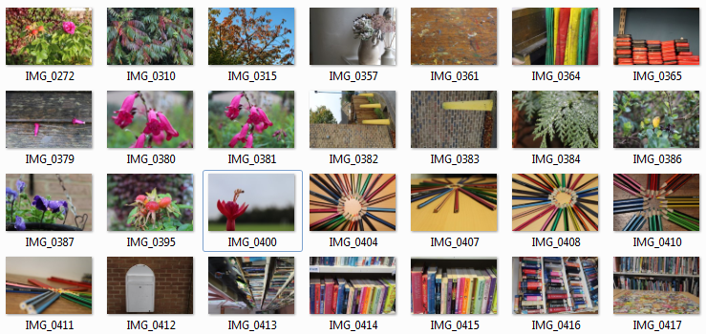
Colour
For colour as a visual element, I took 28 photos. I tried to vary my photos between natural elements and also creative elements like paint or coloured pencils. I organised coloured pencils in a certain order to make an aesthetic photo, which I also edited (shown on the next slide). Overall, I am pleased with my photos for colour.

Slide 4
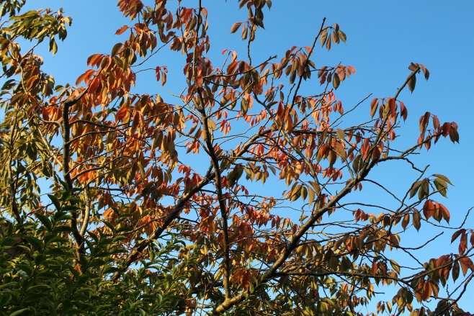
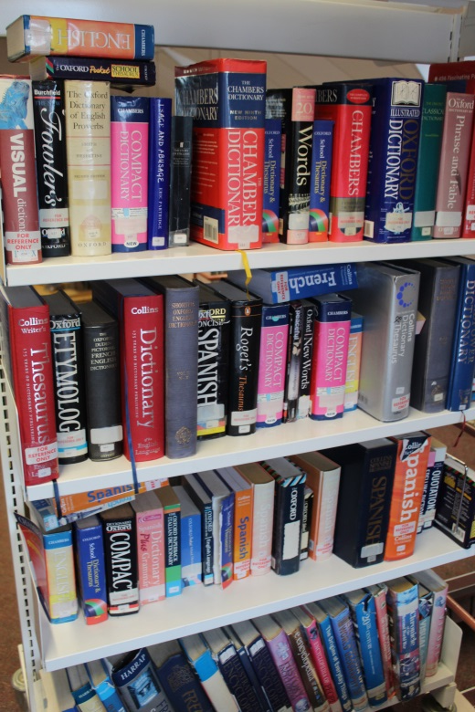
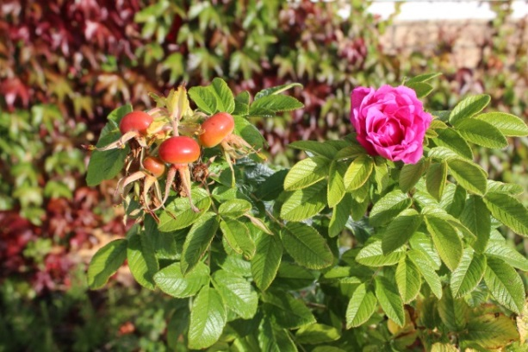
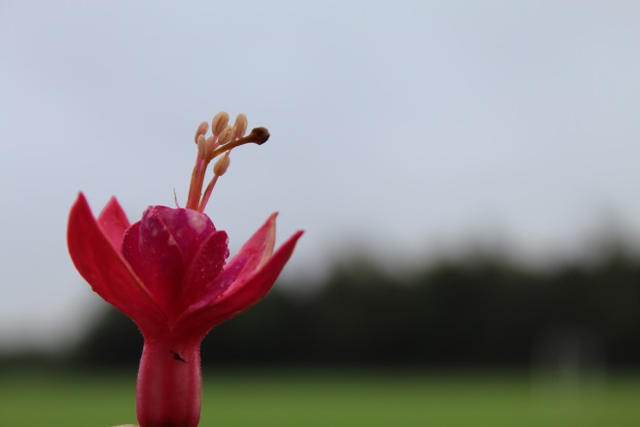
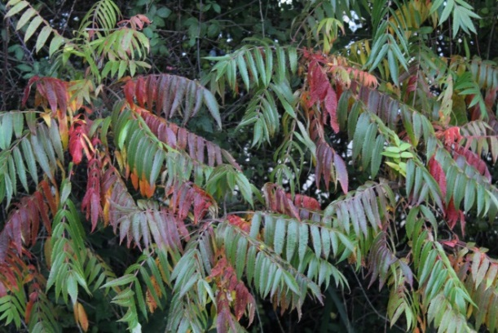
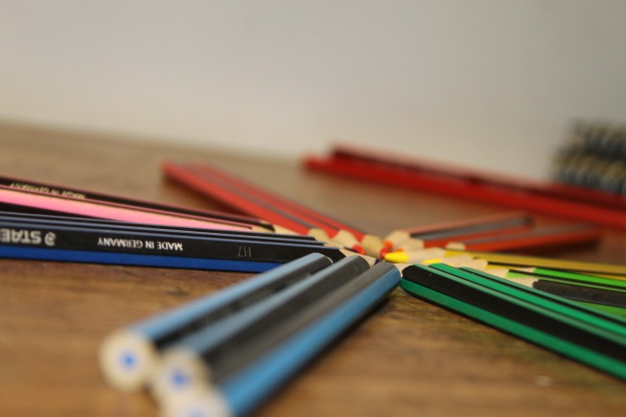
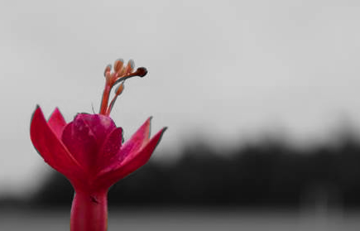
Colour
Focused and good colour contrast.
I don’t like the colour combination shown in the image.
I like the blurred background
I don’t like the blurred pencil ends.
(Edited) (Edited) I like the burst of colour.

Slide 5
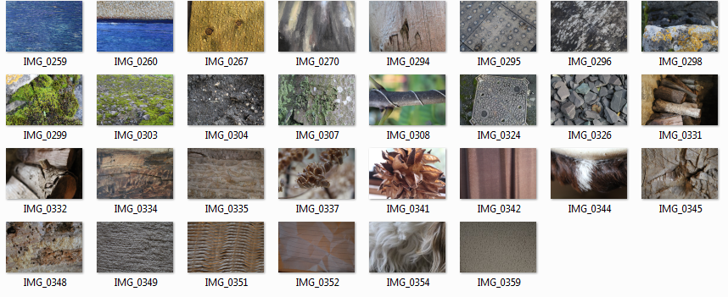
Texture
For texture, I have taken 30 photos. I tried to vary the textures between fur, stones, and wooden textures. I think my photos turned out well but I think I should have taken photos of more variety. Overall, I am pleased with the photos I have taken but next time I would aim to take a wider variety of photos.

Slide 6
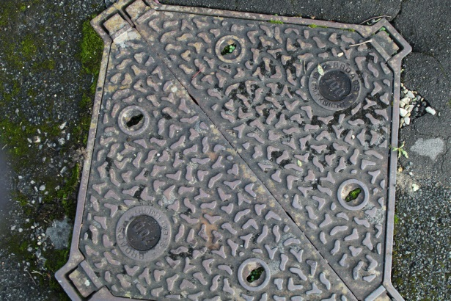
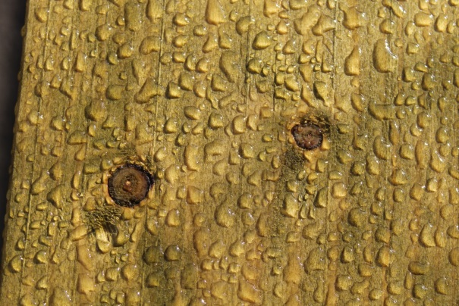
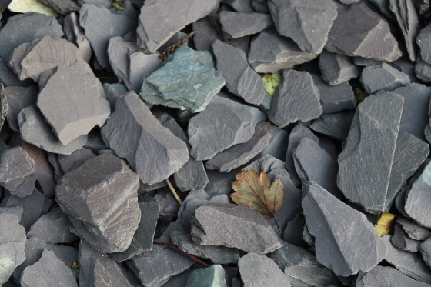
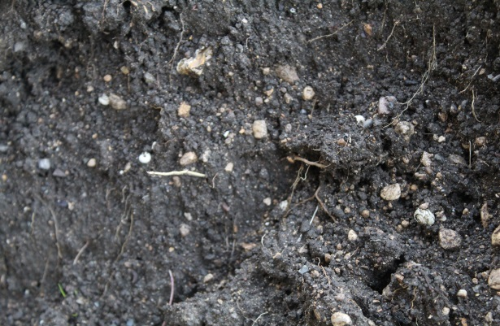
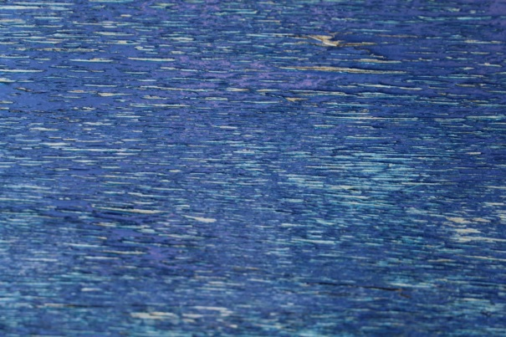
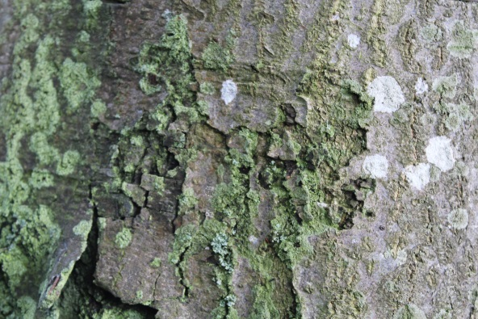
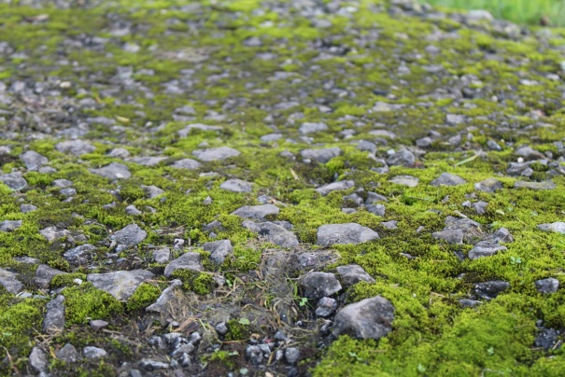
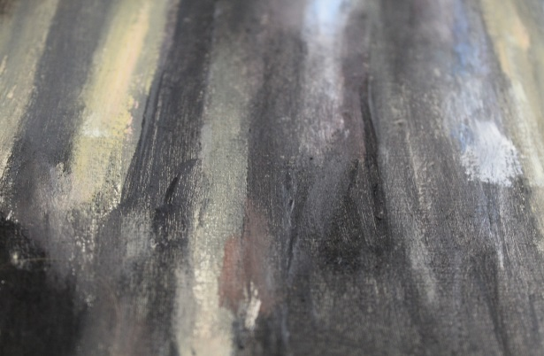
Texture
Bad angle of photo. Not sharp enough
I like the clear texture in the photo.
I like the texture of the stones but the photo is fairly plain.
I like the texture of the wood.
Doesn’t have a clear texture, not focused well.
Good texture shown but the photo needs more texture present.
No clear texture
I like the texture of the stones and moss combined together.

Slide 7
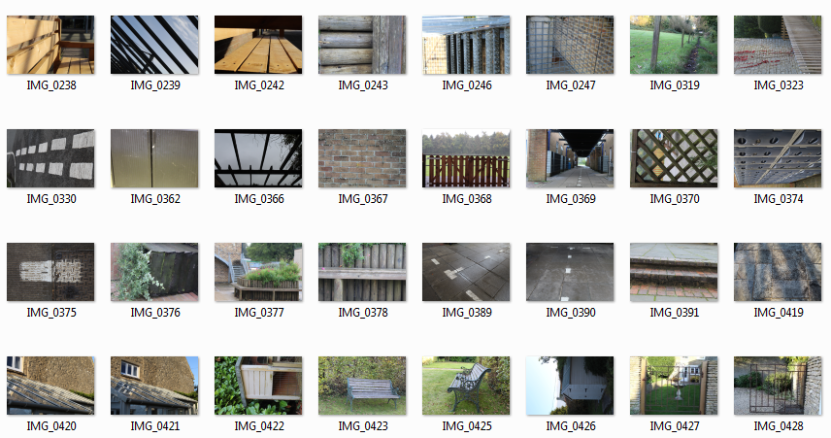
Line
For the visual element ‘Line’ I took a total of 32 photos, including a gate, lines on a road and a patio. I am pleased with the amount of photos I have taken but I don’t think my photos are obvious as the topic ‘Line’. Next time I would take my obvious photos for line but I am still pleased with the outcome of my existing photos.

Slide 8
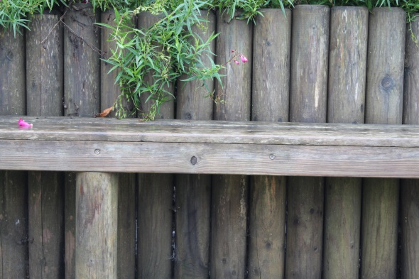
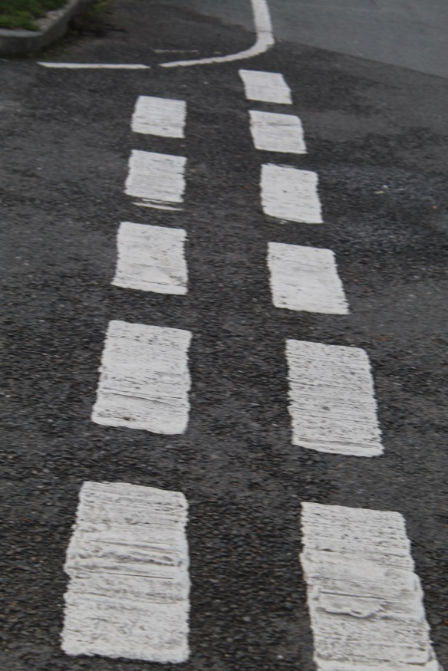
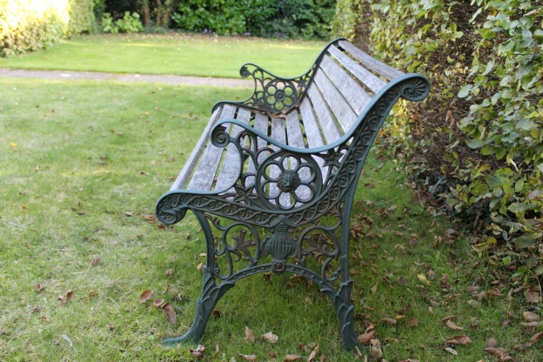
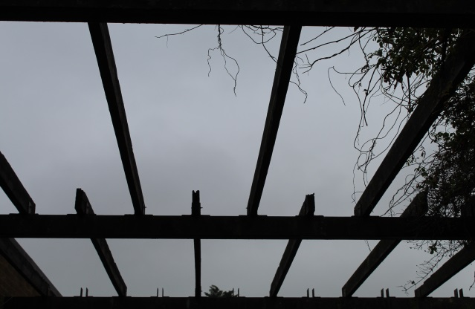
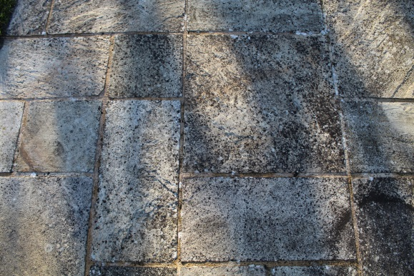
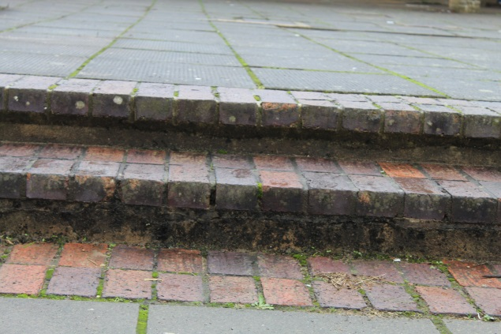
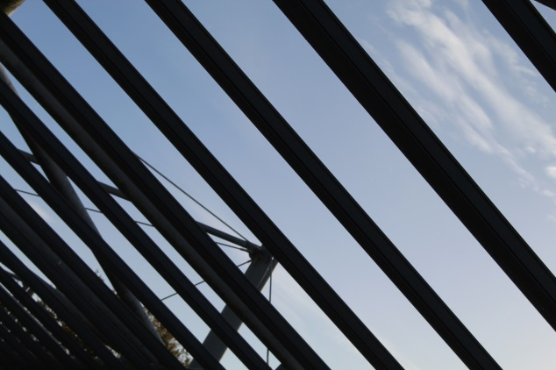
Line
Clearly a ‘line’ photograph
Interesting but not clearly a line image.
Not focused, bad quality image.
Good contrast of light and dark.
Suits the topic line but the lighting of the photo is bad.
Not an interesting image.
Interesting image, good quality.

Slide 9
Best Image - colour

Slide 10
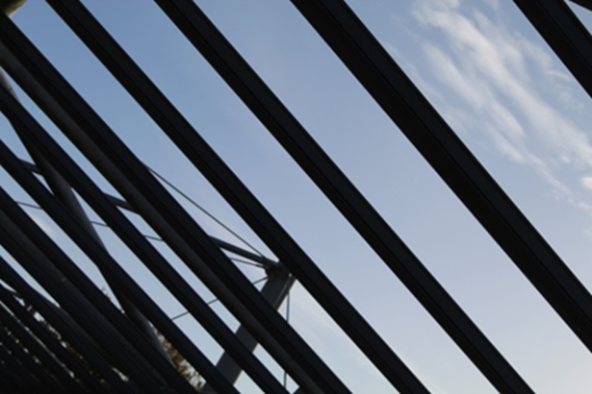
Best Image- Line

Slide 11
Best image-Texture

