Slide 1
THIS WORK SHOULD TAKE YOU ONE WEEK TO COMPLETE PLEASE THEREFORE SPEND AT LEAST 3 HOURS ON THESE 3 SLIDES THANKYOU Y10 WORK HARD

Slide 2
You will need to set your camera to Black & White and get someone else to take a photo of you…
Then find a free online editing suite to edit the photo of yourself and note down the changes you made. I suggest Picmonkey, Pic Art, GIMP.

Slide 3
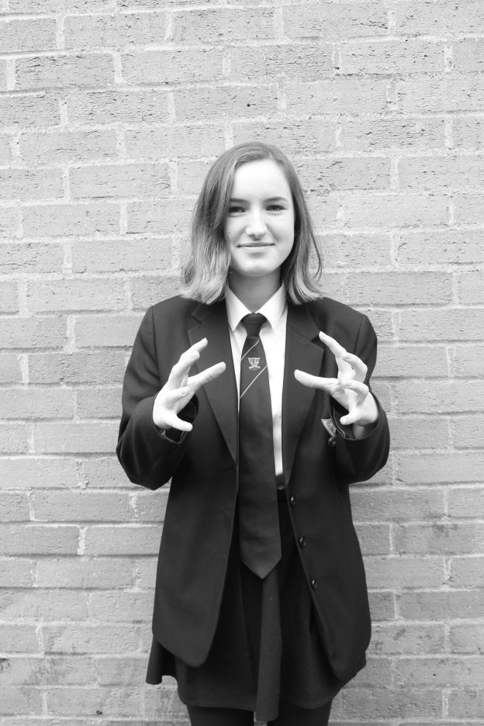
Creative Self Portrait
This photo was taken on the Canon 4000D. My teacher took a photo of me in Monochrome and I chose my own pose in advance so I could edit it a certain way.
Canon EOS 4000D
F-Stop F/4
Exposure time 1/30 sec
ISO 100

Slide 4
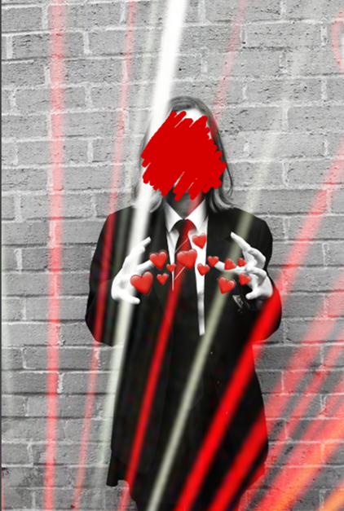
Computer Edit
I used Gimp and Fotor to edit this picture.
When I edited this photo I:
Overlaid a light effect on Gimp
Added a heart sticker
Added a scribble sticker over my face
Changed the brightness and contrast level
I feel more confident using editing apps after editing this photo.

Slide 5
