Slide 1
Work your way through this Photo Essay work – go for an interesting walk in order to take your photos – fit the work over 4 slides. This work should take you TWO weeks to complete so at least 6 hours work.

Slide 2
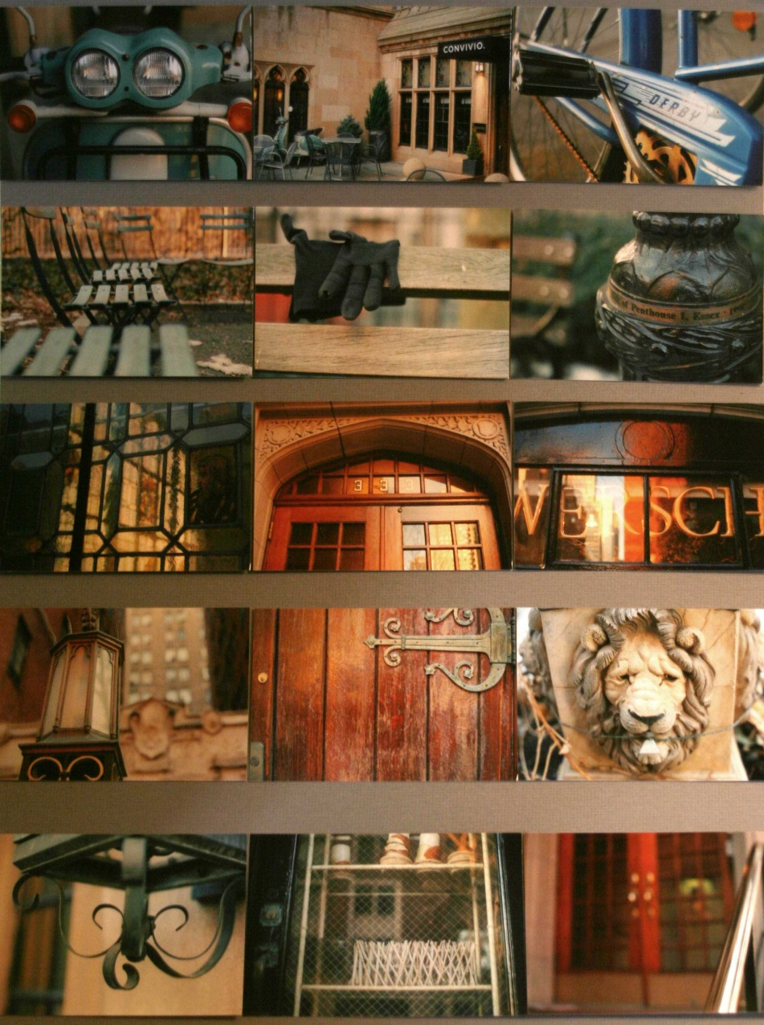
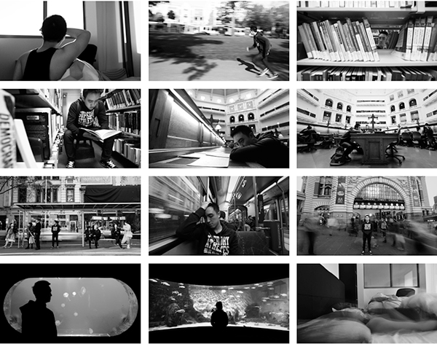
Photo Essay
Brief
Take a series of photographs to use within a Photo Essay which document either; ‘A Sense of Place’ or ‘A Day in my Life’. Try to take between 25 – 50 photographs.

Slide 3
Photo shoot – Walk around Fairford, Wednesday 30th September, 10.30am, overcast with light rain.
Here I took photographs of various things/items/buildings etc I saw whilst out on the walk in and around Fairford. I will now choose a selection of images to take further and place into a Photo Essay which will have a minimum of 3 images. I will use the editing package ‘Picmonkey’ to make some subtle changes to the selected photographs.

Slide 4
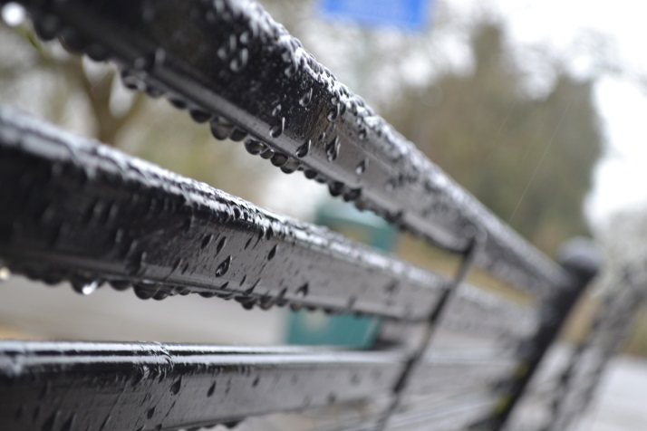
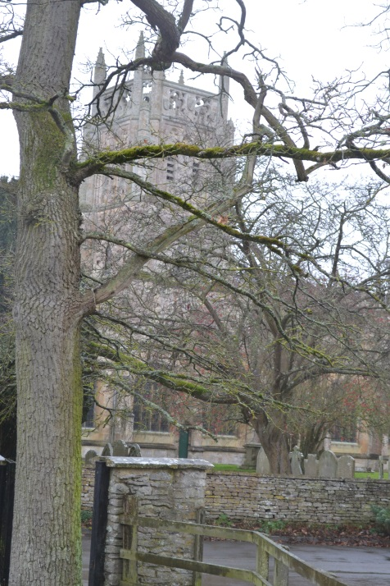
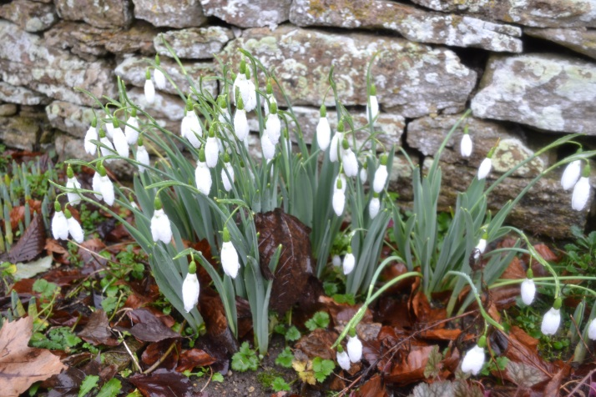
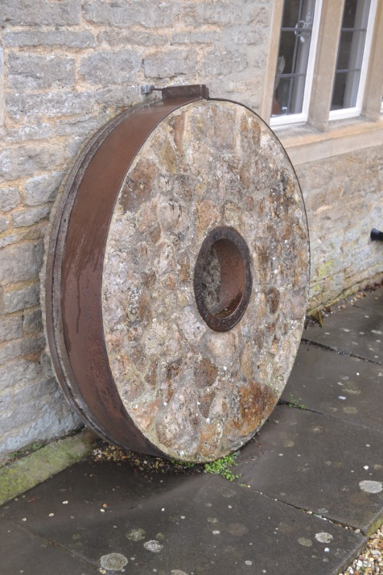
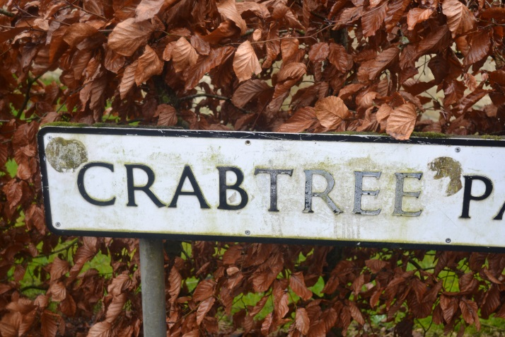
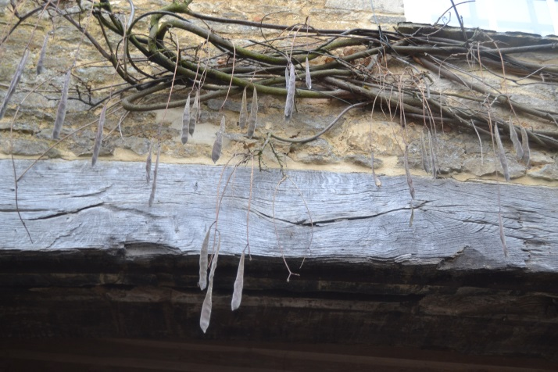
Selected Photographs

Slide 5
Final Piece

