Slide 1
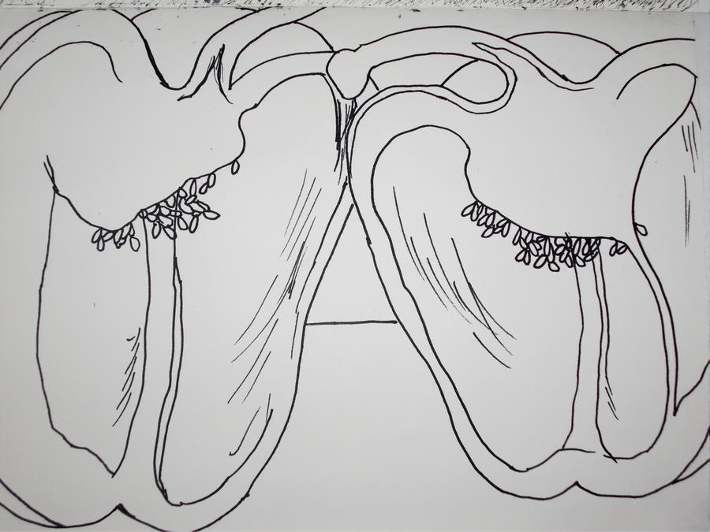
Task lesson one
Top tips
Look at the basic shape of the pepper to start with
Draw in all the detail that you can see
WALT:
Enlarge the scale of an object- Pepper. Draw from life or find a photo online.
WILF:
A clear line drawing of your pepper (A4)
Your image takes the whole of the page
The shape is properly drawn out by the end of the lesson
You start to use paint by the end of the first lesson
Keywords
Enlargement Scale

Slide 2
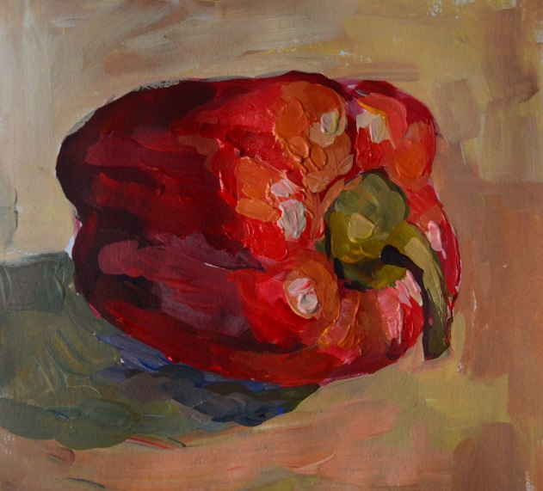
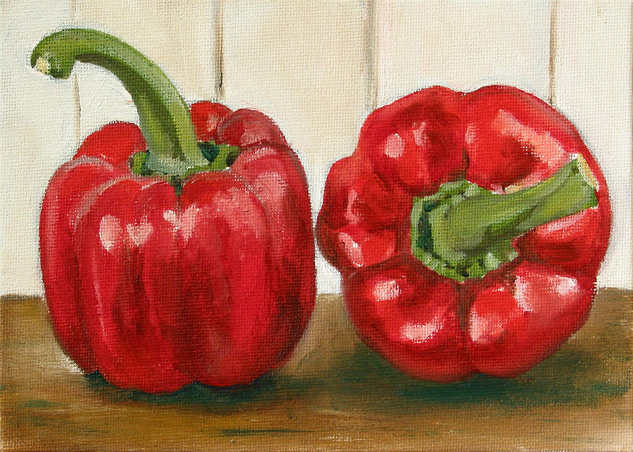
Top tips
Mix your paints to make a colour chart of the tones you can see in the pepper.
WALT:
Render a form in colour using Acrylic paint
WILF:
Your image takes the whole of the page
You mix and blend your paint to show the colours in your pepper.
You finish by the end of lesson two
Keywords
Acrylic Blend Render Texture
Tone Colour

Slide 3
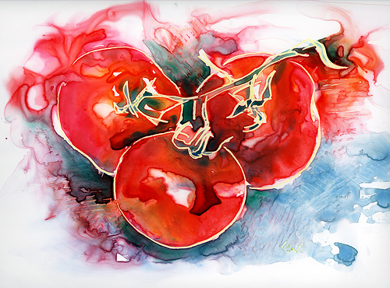
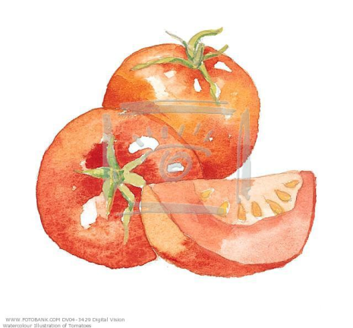
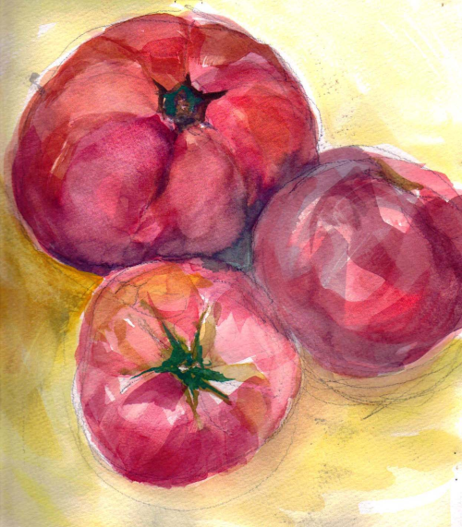
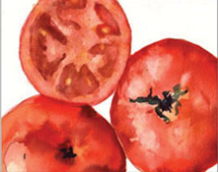
Top tips
Make sure your paint in diluted with water
Paint in layers of colour
Prepare your paint surface before painting
Use colour pencil over the top of dry watercolour to add depth
Task
WALT:
Experiment and use watercolour paint to record the form of a tomato
WILF:
You are going to create three experimental paintings in watercolour paint –
Wet on dry- ( watercolour on dry paper)
Wet on wet- (watercolour on wet paper,)
A salt affected watercolour painting
Make sure each individual piece is approx A5 size
Keywords
Watercolour paint
Tones
Wash
Layer
Wet on dry
Wet on wet
Salt

Slide 4
1. Wet on dry- ( watercolour on dry paper)
Top tips;
Draw from life ( an arrangement of cut up tomatoes) or from a photo
Very lightly sketch out the shapes filling an A5 piece of paper
Mix your watercolour paints and remember- add lots of water.
Build up your layers of paint to create your painting

Slide 5
2. Wet on wet watercolour painting
Top tips;
Damp a piece of A5 cartridge paper
Draw from life ( an arrangement of cut up tomatoes) or from a photo
Very lightly sketch out the shapes filling an A5 piece of paper
Mix your watercolour paints and remember- add lots of water.
Build up your layers of paint to create your painting

Slide 6
3. Salt effect on watercolour
To create a salt effect on watercolour, you need to sprinkle the salt on to wet paint.
-Damp a piece of A5 cartridge paper
-Draw from life ( an arrangement of cut up tomatoes) or work from a photo
-Very lightly sketch out the shapes filling an A5 piece of paper
-Mix your watercolour paints and remember- add lots of water.
- Sprinkle some salt onto your wet painting and leave to dry.
- For how to add salt to your wet paint, follow this link and watch from 1.00min-3.04mins of the video.
https://www.youtube.com/watch?v=hX456nzWVV4

