Slide 1
Y10 Art Topic One

Slide 2
Year 10 GCSE Art Home Learning
Work through the following slides, lesson by lesson.
If you click on a slide that you have done already ( at home or at school) go to the next slide…
If you have completed all of this topic, go to the next topic.

Slide 3
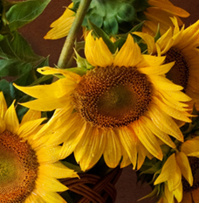
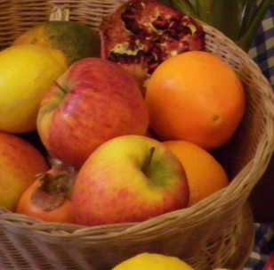
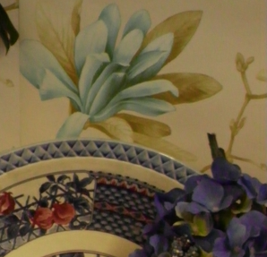
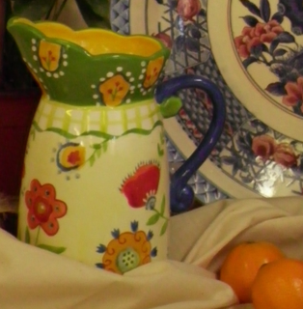
Natural Forms year 10 Task one - Close up observation drawings of natural forms. Select three out of the five close- up photos on this slide. If needed, print out images from following slides
Lesson one/two - Work on Square paper 12cm x 12cm.
Trace or draw in freehand one of the images to fill the square box .

Slide 4
Use these images to print out/trace from

Slide 5
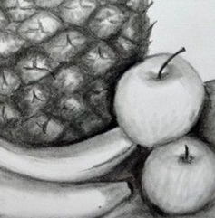
Once you have traced or drawn out your first image.
Add detail and tonal shading
See example;
Tonal shading example

Slide 6
Lesson two /three- Choose another close up image. Trace or draw out onto 12cmx12cm square paper Draw out lightly in pencil, add detail. Then carefully colour in using coloured pencils. Make sure you blend colours together. Fill the square with colour and detail
Example using coloured pencil

Slide 7
Lesson three/four Complete Coloured pencil drawing from last lesson. Next; Choose your next close up image and draw or trace it out lightly in pencil. You are going to spend the next two lessons mixing colour and then painting this square in acrylic paints. You need to spend your time mixing the correct colours in order to get the right colour tones. Draw out a tonal ladder and apply the colours into the squares (See example). Apply the paint carefully and take your time.
Example of painted colour tonal ladder

Slide 8
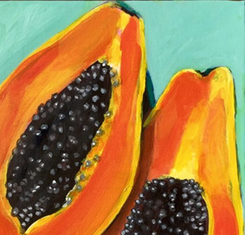
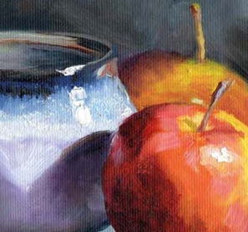
Lesson four/five Continue to paint your Acrylic square. You need to spend your time mixing the correct colours in order to get the right colour hues and tones. Apply the paint carefully and take your time.
Examples of Acrylic painting

