Slide 1
Y 10 Art Topic three

Slide 2
Photography Task- 2 lessons
Over half term take a set of photos. These images are going to inspire a FINAL PIECE based on the Artist Mark Hearld. They could be;
Gardening utensils, fork, spade, wheelbarrow, watering can.
A garden shed or greenhouse.
A view of an allotment
Your back garden, flower bed, vegetable patch
A landscape of field and trees
Think what else you could take photos of.
You will then create a contact sheet of the photos and select the best ones through a RAG rating method.
Red= No
Amber= maybe
Green= Yes

Slide 3
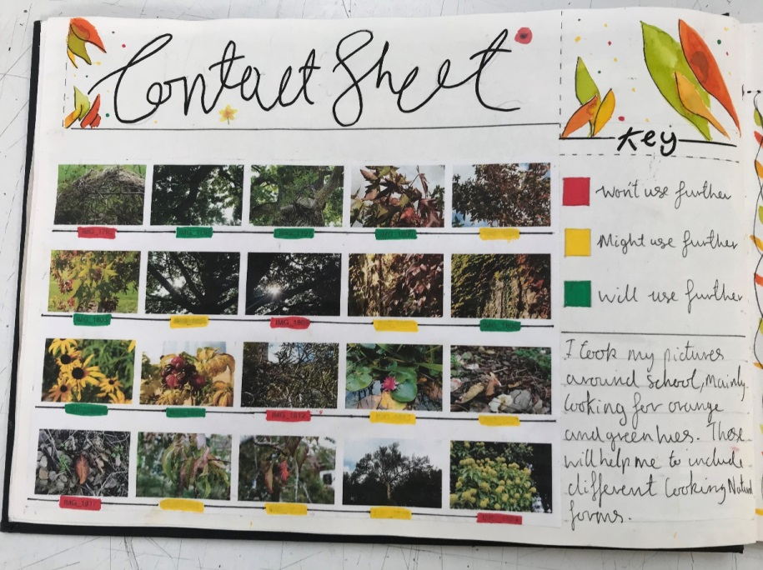
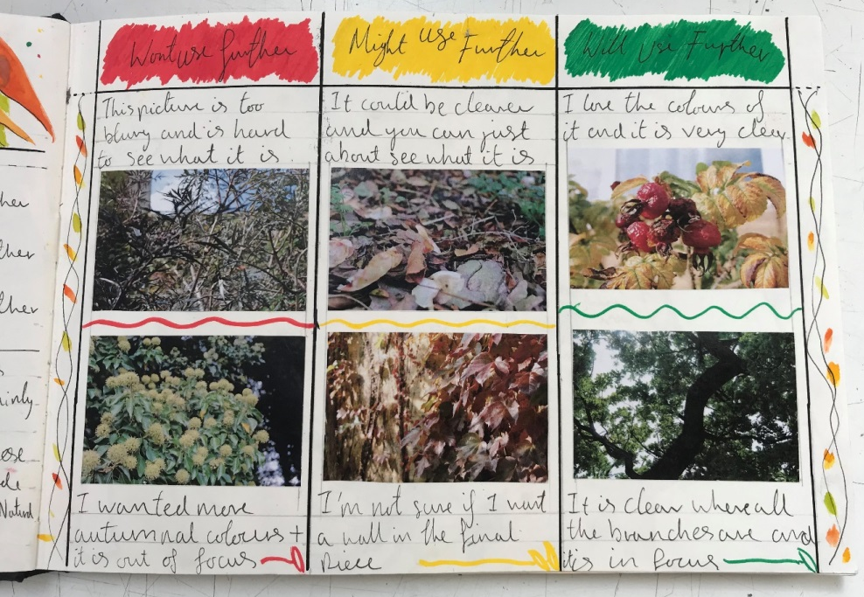
Lesson two
Look at the layout below and print out all of your photos as a contact sheet ( left hand page).
Then, use the RAG rating technique to select six of your best images ( right hand page) .
Primary research- taking photos - RAG rating and selecting
R= Red
A = Amber
G = green

Slide 4
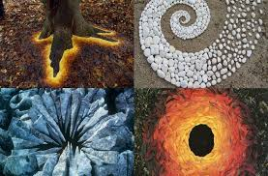
Andy Goldsworthy- Land Art
Andy Goldsworthy..
(born 26 July 1956)
..is a British sculptor, photographer and environmentalist who produces site-specific sculptures and land art situated in natural and urban settings.
He works with the landscape to create his work, using found natural forms to make artworks that are temporary and stay in the landscape.
He then photographs his work as a record of it.
Goldsworthy will re visit the work over a period of time to photograph how it has changed.
He lives and works in Scotland.

Slide 5
Task
We want you to create your own Andy Goldsworthy sculpture.
You can use, stones, pebbles, leaves, fallen petals, sticks ( from the ground) plants in pots, basically anything that you find.
When you are happy with your Land sculpture, photograph it, print it out to add to your double page later.

Slide 6
Make an interesting double page about Andy Goldsworthy
Follow these links to understand a bit more about Goldsworthy's work;
https://www.youtube.com/watch?v=FPDH8yCnlk0
https://www.youtube.com/watch?v=LP_-P7ZcWZU
From the information you have collected so far about Andy Goldsworthy
Create a double page layout in your sketchbook
Use your own skills, drawings, sketches to decorate the page. You could add rubbings of bark and leaves as a background.
Add CPMJC to analyse one of Goldsworthys works or to analyse his work as a whole

Slide 7
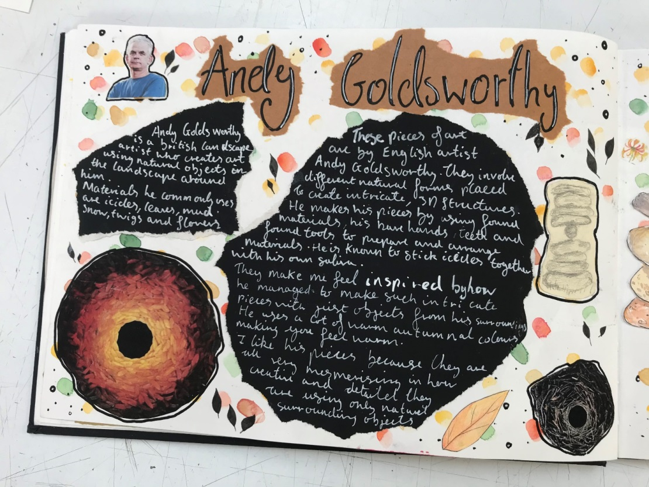
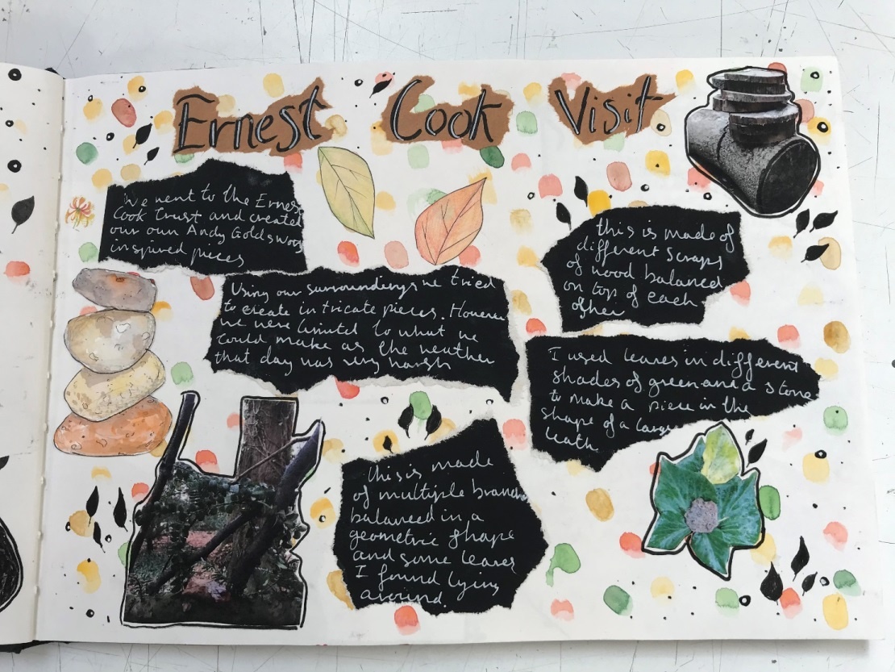
Andy Goldsworthy- 2 week double page
To include own Goldsworthy response for HW.
See following slides for help

