Slide 1
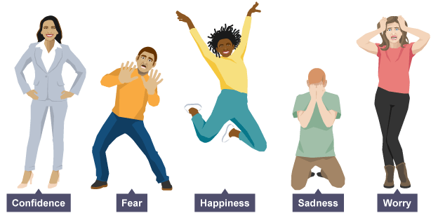
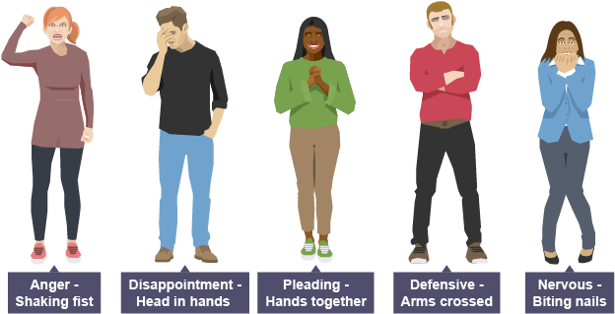
Physical Skills
TASK: Write these skills in your book and try out the different skills at home.
Extension: Illustrate your written notes with drawings showing different stances and facial expressions.
Stance: The position of your feet on the floor (wide, narrow, etc.)
Posture: How you hold your back when standing or sitting (upright, hunched, slouched, etc.)
Gesture: The movement of your hands, arms, shoulders and heads to show meaning
Facial Expression: The way that you move your face to express emotion
Gait: The way a character walks

Slide 2
Vocal Skills
TASK: Write these skills in your book and try out the different skills at home.
Extension: Illustrate your written notes with drawings
Pace: The speed at which you are talking (fast or slow)
Pitch: How high or low you are speaking
Tone: Showing a feeling/emotion in the way you speak
Volume: How loudly or quietly you are speaking
Accent: Using your voice to show the location a character comes from

Slide 3
Stagecraft Skills
TASK: Write these skills in your book
Characterisation | Experiment with vocal and physical skills to create a character who is different from you.
Tableau/x | A still image or frozen picture that tells a story using exaggerated physical skills. It must be still and silent
Facing the Audience | The position a performer stands in to ensure the audience can see their performance clearly
Rehearsal | The process of experimenting with skills and getting ready for performance
Feedback | The best feedback gives the performer a positive comment on their use of skills and a suggestion to improve their skills in performance

Slide 4
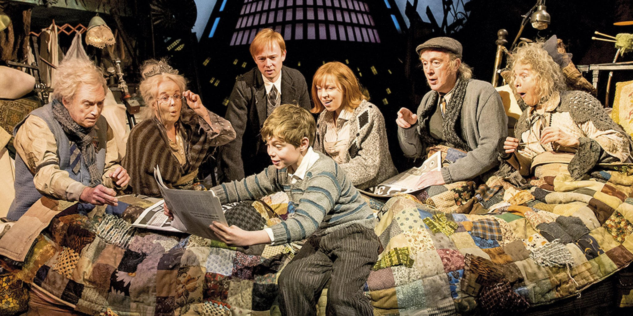
What meaning does this tableau create
for the audience?
Describe the facial expressions, use of posture & gesture,
costume, set & props.
What do these things suggest about the characters and their situation?

Slide 5
Exploring A Text
Charlie Bucket
is the central character in the novel Charlie and the Chocolate Factory by Roald Dahl. The novel has been adapted into films, stage plays and a musical.
Charlie lives with his Mum and Dad, Grandpa Joe, Grandma Josephine, Grandpa George and Grandma Georgina
Look carefully at the image above.
Describe the physical skills you can see the performers using.
What might this tell the audience about Charlie, his family and the way they live?

Slide 6
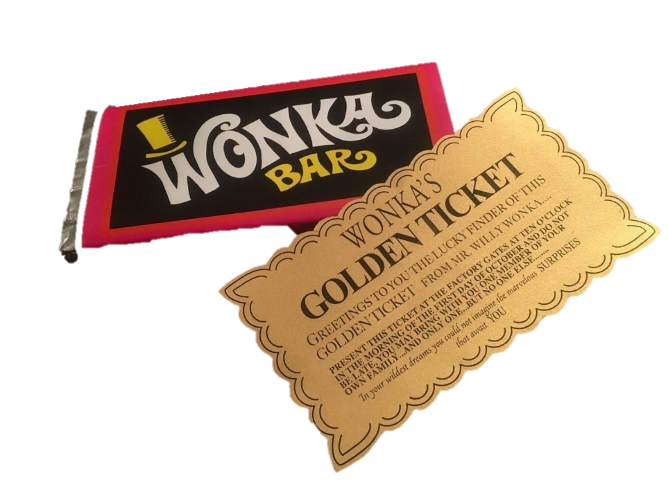
Plot: The sequence of events in a play (the story)
TASK: Write the key points of the plot in your book
Eleven-year-old Charlie Bucket lives in poverty in a small house with his parents and four grandparents.
One day, Grandpa Joe tells him about the legendary and eccentric chocolatier Willy Wonka and all the wonderful sweets and chocolates he made until the other chocolatiers sent in spies to steal his secret recipes, which led him to close the factory to outsiders.
The next day, the newspaper announces that
Mr Wonka is re-opening the factory and
has invited five lucky children to come on a tour,
if they find a Golden Ticket inside a Wonka Bar.
https://youtu.be/KR8PscR6N2s

Slide 7
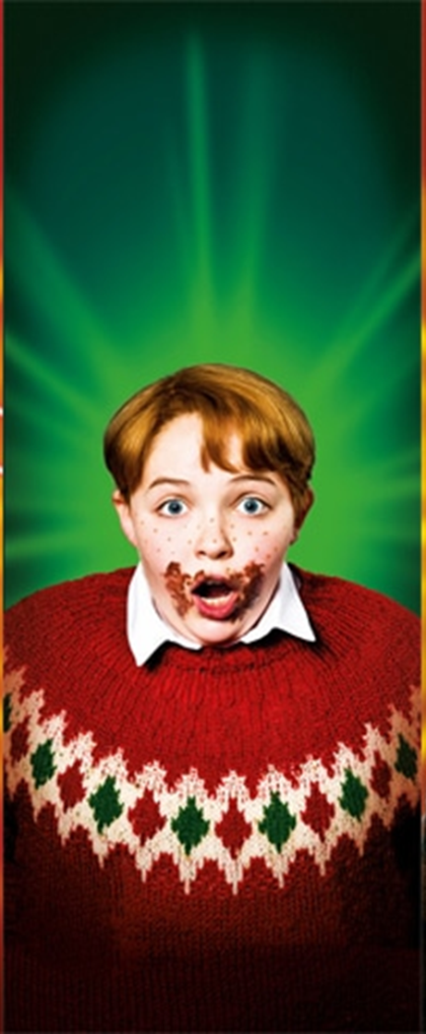
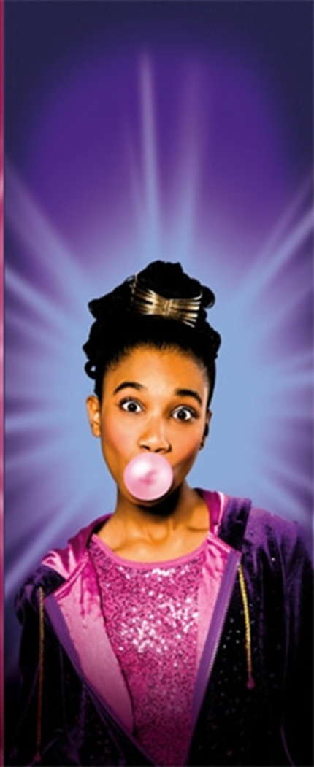
The first four golden tickets are found by…
TASK: Watch the four video links to YouTube. Make notes on what you learn about each of the four characters
…the gluttonous
Augustus Gloop,
the
spoiled and petulant
Veruca Salt,
the chewing gum-addicted
Violet Beauregarde,
and the screen-obsessed
Mike Teevee.
https://youtu.be/FHKOkVVyAVM
https://youtu.be/9_s-OrWz_Z8
https://youtu.be/SS9UYJSOJDE
https://youtu.be/tJpLEbkfXXQ

Slide 8
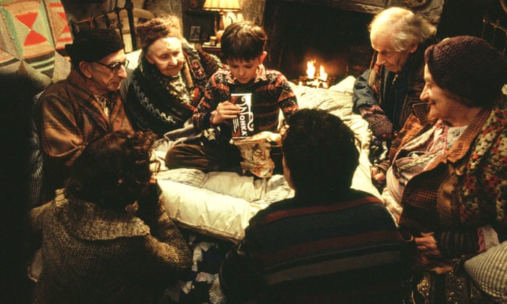
Plot: (Continued…)
TASK: Write the key points of the plot in your book
1) It is Charlie’s birthday.
The Bucket family do not have much money for presents, but they have managed to save enough pennies to buy Charlie a Wonka Bar for his birthday.
2) They all gather around as Charlie slowly opens
the Wonka Bar.
Will there be a golden ticket inside?
Will there…?
Will there…?
Will there…?
No.
3) Charlie shares his chocolate with the family. It is a welcome change from cabbage soup so they relish the taste of the sweet chocolate treat.
TASK: Draw three tableaux (pictures) of the moments described above.
Draw the characters’ facial expressions to show their different emotions.

Slide 9
Plot: (Continued…)
TASK: Watch the video link below and write the key points of the plot in your book.
One cold day, as he walks home from school, Charlie sees a 50 pence piece buried in the snow. He picks it up and looks around to see who might have dropped it, but there’s no one around. He has a moral dilemma.
He goes into the nearest shop, buys a Wonka Bar and finds the fifth and final golden ticket.
The other customers in the shop offer Charlie lots of money in return for the golden ticket, but he runs all the way home to show his family.
Charlie tells them how much money they could sell the golden ticket for.
Despite how much the family could benefit from the money, they decide that Charlie should go to Willy Wonka’s chocolate factory and that Grandpa Joe should go with him.
https://youtu.be/KR8PscR6N2s
https://youtu.be/KR8PscR6N2s

Slide 10
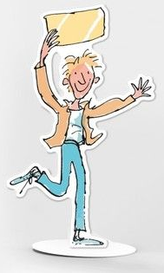
Character Profile
A character profile is a useful way of recording facts and ideas to help a performer develop their characterisation.
Name: Charlie Bucket
Age: 11
Relationships: Grandpa Joe, Grandma Josephine, Grandpa George, Grandma Georgina, Mum & Dad
Personality: Kind, Generous, Honest, Good Hearted, Curious, Wise, Respectful
Look at the example opposite and use it to model a character profile of your own for the character of Charlie.
There’s a blank character profile on the next slide that you can copy or print and stick in your book.
What words can you think of to describe Charlie’s character?
What ideas do you have for how you might use your physical and vocal skills to explore the character of Charlie?
Draw a portrait of Charlie.
Physical Skills:
Gesture: Wide open arms
Posture: Upright, Straight back
Facial Expression: Wide eyes, Large smile
Gait: Light footed, Jumpy
Stance: Feet shoulder width apart, straight legs
Vocal Skills:
Pitch: Slightly Higher
Pace: Slightly Slow
Volume: Quiet
Accent: No particular location but needs to show that he is poor
Tone: Soft, Calm

Slide 11
Name: Charlie Bucket
Age:
Relationships:
Personality:
Physical Skills:
Gesture:
Posture:
Facial Expression:
Gait:
Stance:
Vocal Skills:
Pitch:
Pace:
Volume:
Accent:
Tone:

Slide 12
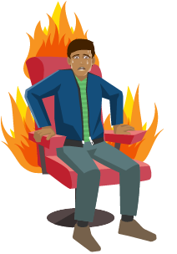
Hot Seating
Hot seating helps a performer to understand their character better.
A performer sits in the ‘hot-seat’ and is asked questions. The performer answers as their character – using vocal and physical skills and a lot of imagination!
The people asking the questions should take notes about what the character in the hot seat says and the physical and vocal skills that the performer uses.
The questions need help the performer use their imagination and think about their character’s background, family, friends, hobbies, school-life, likes and dislikes, etc.
What does your bedroom look like?
What’s your favourite subject at school and why?
Who is in your family and what are they like?
How do you feel about going to the chocolate factory?
TASK: Write a list of questions you would like to ask Augustus, Veruca, Violet and Mike

Slide 13
Name:
Age:
TASK: Choose one of the ticket winners and complete a character profile for them.
Relationships:
Personality:
Physical Skills:
Gesture:
Posture:
Facial Expression:
Gait:
Stance:
Vocal Skills:
Pitch:
Pace:
Volume:
Accent:
Tone:

Slide 14
Revise
everything you have
learned this term and complete the
multiple choice quiz
set on
Show My Homework

