Slide 1
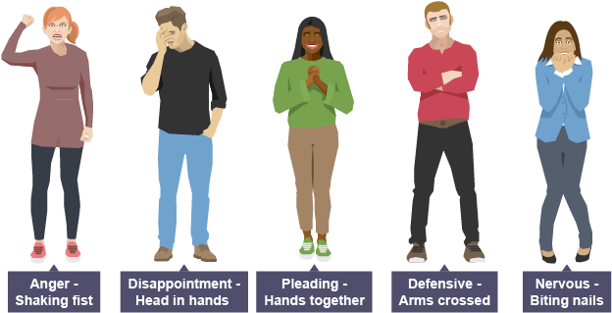
Physical Skills
TASK: Write these skills in your book and try out the different skills at home.
Extension: Illustrate your written notes with drawings showing different stances and facial expressions.
Stance | The position of your feet on the floor (wide, narrow, etc.)
Posture | How you hold your back when standing or sitting (upright, hunched, slouched, etc.)
Gesture | The movement of your hands, arms, shoulders and head to show meaning
Facial Expression | The way that you move your face to express emotion
Gait | The way a character walks

Slide 2
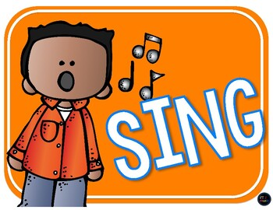
Vocal Skills
TASK: Write these skills in your book and try out the different skills at home.
Extension: Illustrate your written notes with drawings
Pace | The speed at which you are talking (fast or slow)
Pitch | How high or low you are speaking
Tone | Showing a feeling/emotion in the way you speak
Volume | How loudly or quietly you are speaking
Accent | Using your voice to show the location a character comes from
Projection | A strong, clear and loud voice so the audience can hear

Slide 3
Stagecraft Skills
TASK: Write these skills in your book
Rehearsal | The process of experimenting with skills and getting ready for performance
Blocking | The process of placing performers in a specific space
Spatial relationships | The distance between performers that shows the relationship between characters
Facing the Audience | The position a performer stands in to ensure the audience can see their performance clearly
Tableau/x | A still image or frozen picture that tells a story using exaggerated physical skills. It must be still and silent
Characterisation | Experiment with vocal and physical skills to create a character who is different from you.
Feedback | The best feedback gives the performer a positive comment on their use of skills and a suggestion to improve their skills in performance

Slide 4
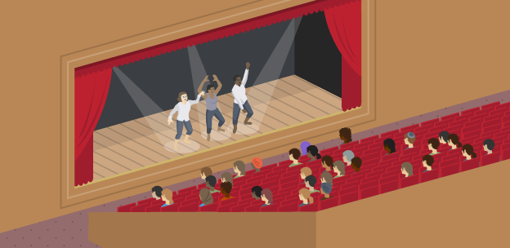
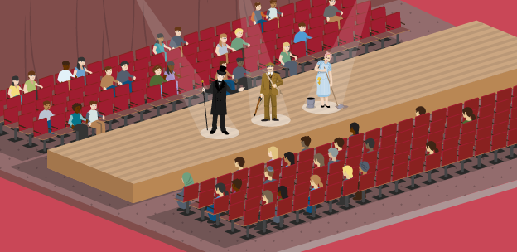
Staging
Task: Write the information and draw the diagrams (on the right) in your book
There are many different types of staging, each presenting unique challenges and opportunities when creating a performance:
End-on Staging
When the audience sit on one side of the stage or space, facing it in the same direction
Stage
Audience
Traverse Staging
When the audience sit on two sides of the space or stage, facing each other
Audience
Stage
Audience

Slide 5
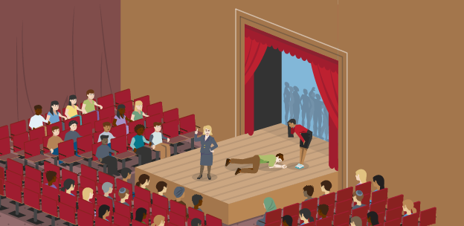
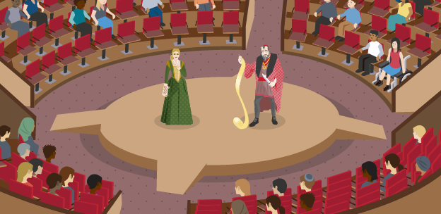
Staging
Task: Write the information and draw the diagrams (on the right) in your book
Thrust Staging
When the audience sit on three sides of the stage or space and the fourth side leads backstage
Audience
Stage
Audience
Audience
In The Round
When the audience surround a performance space or stage on all sides, and the performers enter and exit through the audience
Audience
Audience
Stage
Audience
Audience

Slide 6
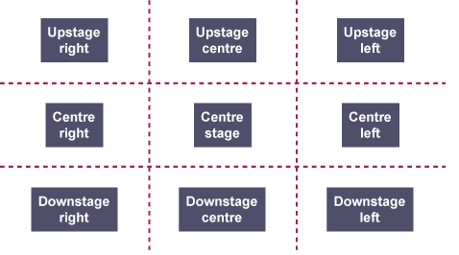
Areas of the Stage
Task: Write the information and draw the diagram in your book
The nine areas of the stage are used to help keep track of where performers and items of set are positioned during rehearsal and performance.
They are from the perspective of the performer – not the audience!
Audience

Slide 7
Exploring A Text
TASK: Write the title and copy all the following information in your book
Hansel & Gretel is a German fairy tale collected by the Brothers Grimm and published in 1812.
Hansel and Gretel are young children, abandoned and lost in the forest, where they fall into the hands of a cannibalistic witch, living in a house made of gingerbread, cake and sweets.
The witch intends to fatten the children before eventually
eating them, but Gretel outwits and kills her.
The two children escape and return home
with the witch’s treasure.
Look carefully at the performers in
these tableaux from the play.
Describe the physical skills and costumes you the performers are using.
What might these tell the audience
about style of the play?

Slide 8
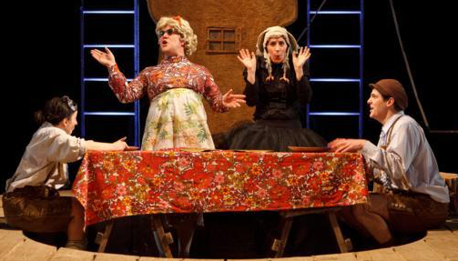
TASK: Read the original story below and write the key plot points in your book OR…..
Hansel & Gretel by the Brothers Grimm
The story is set in medieval Germany. Hansel and Gretel are the children of a poor woodcutter. When a famine settles over the land, the woodcutter's wife decides to take the children into the woods and leave them there to fend for themselves so she and her husband will not starve to death. The woodcutter opposes the plan but finally, reluctantly submits to his wife's scheme, unaware that Hansel and Gretel have overheard them. After the parents have gone to bed, Hansel sneaks out of the house and gathers as many white pebbles as he can, then returns to his room, reassuring Gretel that God will not forsake them.
The next day, the family walk deep into the woods and Hansel lays a trail of white pebbles. Their father lights a fire for them in the woods, and goes to gather more wood. After a while, the children realise the father isn't coming back. Gretel cries, but Hansel tells her all will be fine. After nightfall, they follow his shiny pebbles back to the house, arriving by morning. Their father is overjoyed, and takes them back in as he was very upset about leaving them in the first place.
Famine strikes again, and the stepmother insists that they take the children back to the forest to leave them. This time, she locks the door to their room so Hansel is unable to gather pebbles. Clever Hansel crumbles up the small piece of bread he is given by his parents, and sprinkles crumbs along their path. Unfortunately, birds eat the crumbs, and they can't find their way home. After searching for a very long time, they come upon a house in the woods made of breads and cakes.
They eat from the house, as they're very hungry. While they are eating, a witch comes out and invites them inside, offering them a meal, and pretending to be a kind and friendly old woman. After feeding them, she traps them in her house and makes them do chores each day, feeding them well in order to fatten them up for eating.
One day, the witch decides it is time to eat, and has Gretel light the oven and provide water for boiling her brother. After a while, the witch asks Gretel to hop in the oven to make sure it is hot enough to bake bread. Gretel, sensing the witch's intent, pretends she does not understand what the witch means. Infuriated, the witch hops into the oven herself to demonstrate what she wants, and Gretel pushes the door closed behind her, leaving "the ungodly creature to be burned to ashes". Gretel frees Hansel from the cage, and the pair discover a vase full of treasure and precious stones. Putting the jewels into their clothing, the children set off for home. They arrive home to hear that their stepmother has died from unknown causes and their father has not had a happy day since they left their home. They live happily ever after with the witch's wealth.

Slide 9
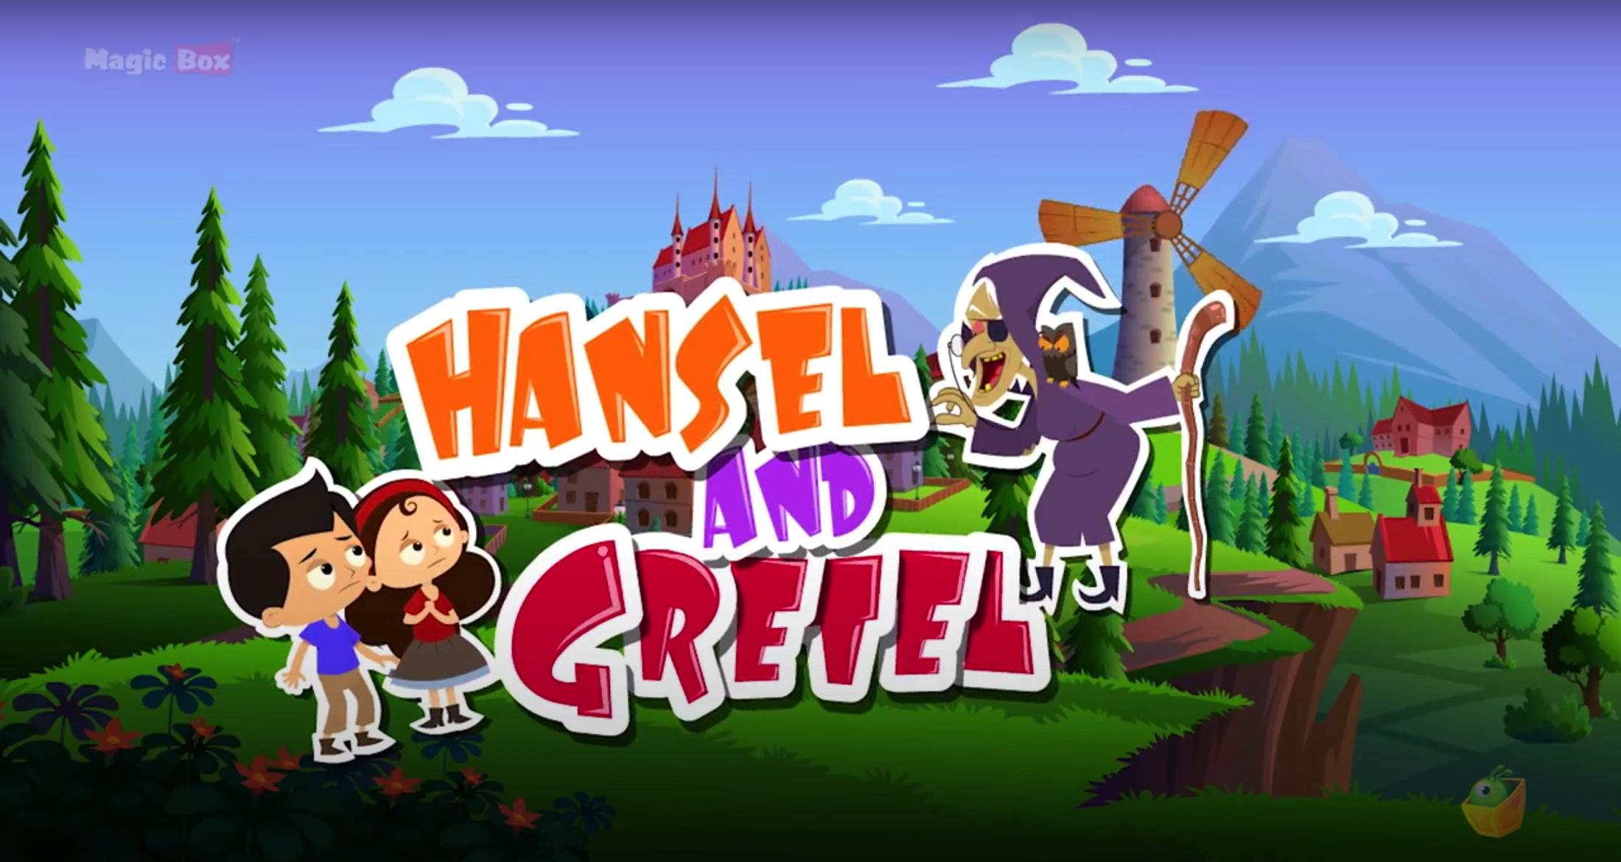
…..Follow the link below and watch this animation based on the original story of
Hansel & Gretel by the Brothers Grimm and write the key plot points in your book
Plot: The sequence of events in a play (the story)
https://youtu.be/xKcDbgxeiTM

Slide 10
Hansel & Gretel Extract 1
Enter Hansel & Gretel. A bird cries, they watch it circle. A white feather flutters down.
Gretel catches it, and tickles Hansel.
HANSEL (Reads his encyclopaedia) Gretel, listen to this. It says here the universe is infinite,
that it has no end… Imagine that!
Gretel tickles Hansel again.
I’m trying to read my encyclopaedia. Did you know that the deepest place in the ocean
is 12 miles?
GRETEL Hansel, look at that apple! A big red one, suspended high above… It’s a beauty! Good enough to eat!
HANSEL It’s too high. We’ll never reach it.
Gretel fetches a huge plank.
HANSEL (Reading) Gretel, did you know that there are over 200 bones in the human body, half of which are in the hands and feet!
GRETEL Hansel, if you’re going to read your encyclopaedia, I’m going to practice my engineering. Come on!
They spring into action, Hansel following Gretel’s orders – collects a lobster pot, bungee cord, the plank, a buoy on a rope. A contraption is assembled.
Hansel? Grab that pot! Put it there, in the middle. We’ll use it as a fulcrum. And this plank will act like a see-saw! Tie it on tight! And find something to tie it on with. Nice and tight! Find something to place on the end… Hansel, I want you to stand on that stool and after I count to three, I want you to jump! Ready?
HANSEL Yes…
GRETEL One, two, three – jump!
Hansel jumps off the stool, onto the end of the plank, which launches the bouy into the air. It hits the apple. It falls into Gretel’s hands.
HANSEL Ohhh, give us a bite!
Hansel takes it off her. Gretel tries to get it back.
GRETEL Give me a bite?
HANSEL Here you are… (Snatches it away.) Can’t have it!
(Offers it.) Here you are… (Snatches it away.) Can’t have it!
(Offers it.) No, really, here you are.
Gretel punches him in the stomach and takes the apple. She takes a bite.

Slide 11
Character Profile
Name:
Age:
Relationships:
Write the title above.
Re-read Extract 1 and circle, highlight or underline the things we learn about the characters of Hansel and Gretel.
Annotate the script with detailed written notes about these things and what we can infer (guess) about the characters.
Think about how you would use your physical and vocal skills to create these two contrasting characters.
Write two copies of the character profile (opposite) in your book. Fill in the details about the characters of Hansel and Gretel so far, and the choices you would make for using your physical and vocal skills as a performer.
Personality:
Physical Skills:
Stance:
Posture:
Gesture:
Facial Expression:
Gait:
Vocal Skills:
Accent:
Pitch:
Pace:
Volume:
Tone:

Slide 12
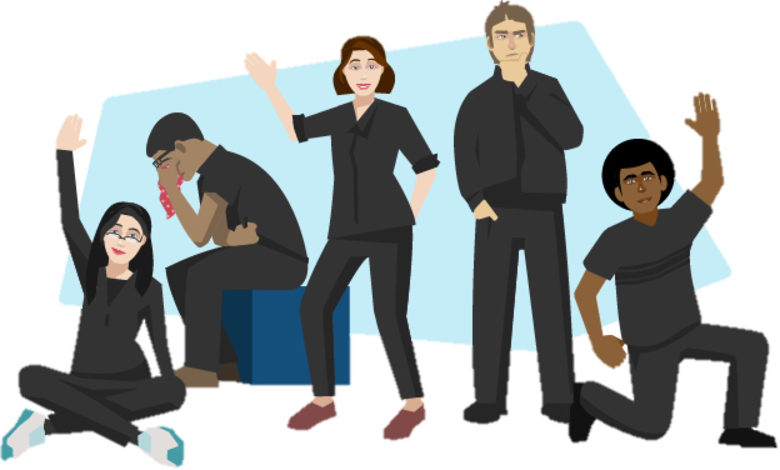
Key Words
TASK: Write these in your book
Duologue | A scene between two characters
Dialogue | Dialogue is when more two or more characters are speaking to each other. The words they say.
Transition | A change from one scene or character to another.
Multi-roling | When a performer plays more than one character onstage. The differences in character are marked by changing physical and vocal skills but the audience can clearly see that the same performer has taken on more than one role.
Marking the Moment | A way of highlighting the most important moment in a scene for the audience such as using a tableau to freeze the action or slow-motion movement.
TASK: Read Extract 2

Slide 13
Extract 2: Father & Hansel
Re-read Extract 2 and circle, highlight or underline the things we learn about the characters of Father and Hansel.
Annotate the script with detailed written notes about these things and what we can infer (guess) about the characters.
Think about how you would use your physical and vocal skills to create the character of Father and write a character profile for him.
Update your character profile for Hansel with any new information and ideas.
When might you use tableau or slow motion to mark the moment and why?
If the characters of Gretel and Father were played by the same performer this would be an example of multi-roling.
The performer would need to use
their physical and vocal skills to
quickly transition into the
contrasting character of Father.

Slide 14
Hansel & Gretel Extract 2
FATHER Timber! (A tree crashes through the air. Enter Father, Axe aloft.) Good morning!
HANSEL Good morning, father!
FATHER What a beautiful day!
Father circles a barrow of wood, sets up a chopping block…
FATHER Hansel, my boy. Put that damn encyclopaedia down. I think it’s high time I taught you how to chop wood. But first, let’s test your strength – fight me, boy.
They take each others’ hand and
FATHER & HANSEL One, two, three, four
I declare a thumb war
Bow, kiss… bow, kiss… bow, kiss…
A game of Thumb War ensues. Father allows himself to be beaten.
FATHER Well done, boy! You are strong! Come! Meet your log!
HANSEL Hello Mr Log!
FATHER Don’t get too attached.
HANSEL Goodbye Mr Log.
FATHER Observe the way the lines in the wood run?
HANSEL Is that called “The Grain”, Father?
FATHER It is, my boy. You’ve been reading your encyclopaedia well. Now you want to chop with the grain, never against it –
HANSEL Father? Will this wood-chopping lesson put me on the right path to becoming…a man?
FATHER Oh, I hope so, son. I hope so.
HANSEL “With the grain, not against it.” Continue. (Father offers his axe to Hansel.)
FATHER That’s it, Hansel. Take a good strong stance! Now, picture yourself as the axe blade – keen and glinty – see the target, lift high and – (Hansel chops the wood.)
FATHER Congratulations, Hansel! Your first piece of kindling!
HANSEL Father, was I a tree once?
FATHER Whatever are you talking about?
HANSEL (Studying his encyclopaedia.) I’ve been reading about Hinduism. It says here that Hindus believe in the concept of reincarnation. They say in a previous life you were something else entirely! I wondered if perhaps I was once a tree, and if it hurt when I was chopped into kindling…?
FATHER Oh Hansel, you’re so clever you’re daft. Come on, boy. Let’s go get a beer!
They go off.

Slide 15
Extract 3: Hansel/Mother & Gretel/Father
Re-read Extract 3 and circle, highlight or underline the things we learn about the characters of Mother and Gretel.
Annotate the script with detailed written notes about these things and what we can infer (guess) about the characters.
Think about how you would use your physical and vocal skills to create the character of Mother and write a character profile for her.
Update your character profile for Gretel with any new information and ideas.
When might you use tableau or slow motion to mark the moment and why?
Imagine that the performer playing Hansel multi-roled as the character of Mother and the performer playing Gretel multi-roled as the character of Father – in the same scene!
The performers would need to use
their physical and vocal skills to
quickly transition into the other characters.

Slide 16
Hansel & Gretel Extract 3
FATHER Timber! (A tree crashes through the air. Enter Father, Axe aloft.) Good morning, children!
HANSEL & GRETEL Good morning, father!
FATHER What a beautiful day!
MOTHER (Dead rabbit aloft.) Good morning, children!
GRETEL Good morning, mother!
MOTHER Rabbit pie for tea!
A flurry of activity as we see the family in their element – happy, noisy, full of life. Gretel & Mother skin the rabbit behind as Father circles a barrow of wood, sets up a chopping block…
FATHER Hansel, my boy. Put that damn encyclopaedia down. I think it’s high time I taught you how to chop wood. But first, let’s test your strength – fight me, boy.
They take each others’ hand and
FATHER & HANSEL One, two, three, four
I declare a thumb war
Bow, kiss… bow, kiss… bow, kiss…
A game of Thumb War ensues. Father allows himself to be beaten.
FATHER Well done, boy! You are strong! Come! Meet your log!
HANSEL Hello Mr Log!
FATHER Don’t get too attached.
HANSEL Goodbye Mr Log.
FATHER Observe the way the lines in the wood run?
HANSEL Is that called “The Grain”, Father?
FATHER It is, my boy. You’ve been reading your encyclopaedia well. Now you want to chop with the grain, never against it –
HANSEL Father? Will this wood-chopping lesson put me on the right path to becoming…a man?
FATHER Oh, I hope so, son. I hope so.
HANSEL “With the grain, not against it.” Continue. (Father offers his axe to Hansel.)
MOTHER (Mother & Gretel skin a rabbit.) That’s it darling. Cut around the throat. Now, remove the skin. Rip it! Rip it!
GRETEL Like this mother?
FATHER That’s it, Hansel. Take a good strong stance! Now, picture yourself as the axe blade – keen and glinty – see the target, lift high and –
Hansel chops the wood as Gretel skins the rabbit. Everyone cheers.
MOTHER Oh well done, darling! One skinned rabbit ready for the pot!
FATHER Congratulations, Hansel! Your first piece of kindling!
HANSEL Father, was I a tree once?
FATHER Whatever are you talking about?
HANSEL (Studying his encyclopaedia.) I’ve been reading about Hinduism. It says here that Hindus believe in the concept of reincarnation. They say in a
previous life you were something else
entirely! I wondered if
perhaps I was once
a tree, and if it hurt
when I was chopped
into kindling…?
FATHER Oh Hansel, you’re so
clever you’re daft.
Come on, boy.
Let’s go get a beer!
They go off.

Slide 17
Revise
everything you have
learned this term and complete the
multiple choice quiz
set on
Show My Homework

