Slide 1
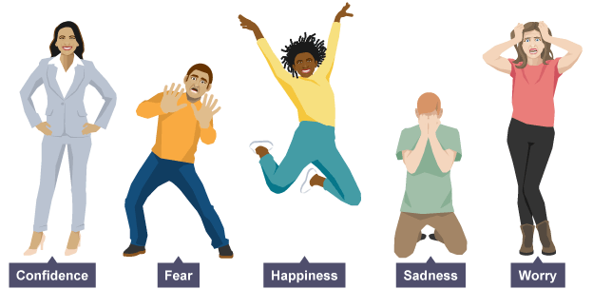
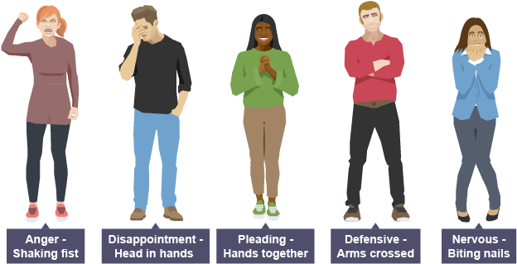
Physical Skills
TASK: Write these skills in your book and try out the different skills at home.
Extension: Illustrate your written notes with drawings showing different stances and facial expressions.
Stance | The position of your feet on the floor (wide, narrow, etc.)
Posture | How you hold your back when standing or sitting (upright, hunched, slouched, etc.)
Gesture | The movement of your hands, arms, shoulders and head to show meaning
Facial Expression | The way that you move your face to express emotion
Gait | The way a character walks

Slide 2
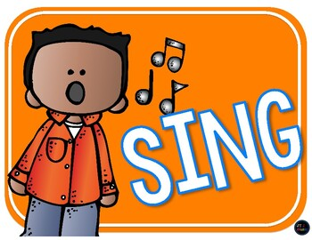
Vocal Skills
TASK: Write these skills in your book and try out the different skills at home.
Extension: Illustrate your written notes with drawings
Pace | The speed at which you are talking (fast or slow)
Pitch | How high or low you are speaking
Tone | Showing a feeling/emotion in the way you speak
Volume | How loudly or quietly you are speaking
Accent | Using your voice to show the location a character comes from
Emphasis | Stress given to a word or words when speaking to indicate particular importance

Slide 3
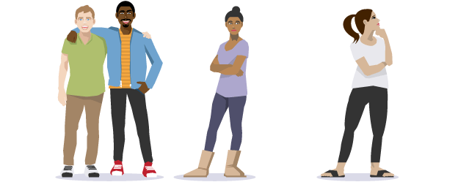
Stagecraft Skills
TASK: Write these skills in your book
Rehearsal | The process of experimenting with skills and getting ready for performance
Blocking | The process of placing performers in a specific space
Spatial relationships | The distance between performers that shows the relationship between characters
Facing the Audience | The position a performer stands in to ensure the audience can see their performance clearly
Tableau/x | A still image or frozen picture that tells a story using exaggerated physical skills. It must be still and silent
Characterisation | Experiment with vocal and physical skills to create a character who is different from you.
Feedback | The best feedback gives the performer a positive comment on their use of skills and a suggestion to improve their skills in performance

Slide 4
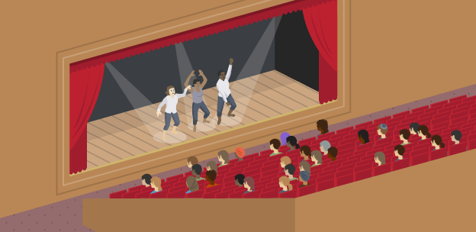
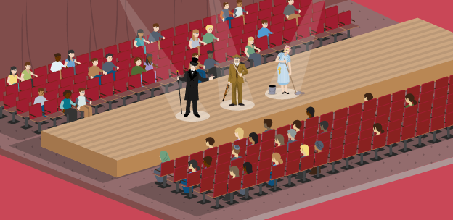
Staging
Task: Write the information and draw the diagrams (on the right) in your book
There are many different types of staging, each presenting unique challenges and opportunities when creating a performance:
End-on Staging
When the audience sit on one side of the stage or space, facing it in the same direction
Stage
Audience
Traverse Staging
When the audience sit on two sides of the space or stage, facing each other
Audience
Stage
Audience

Slide 5
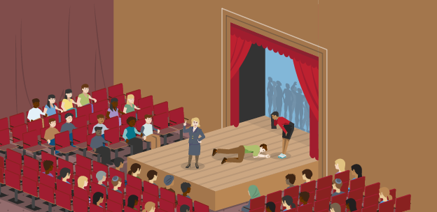
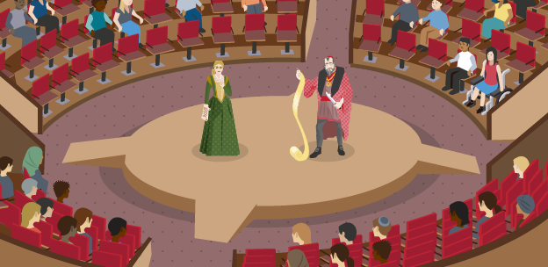
Staging
Task: Write the information and draw the diagrams (on the right) in your book
Thrust Staging
When the audience sit on three sides of the stage or space and the fourth side leads backstage
Audience
Stage
Audience
Audience
In The Round
When the audience surround a performance space or stage on all sides, and the performers enter and exit through the audience
Audience
Audience
Stage
Audience
Audience

Slide 6
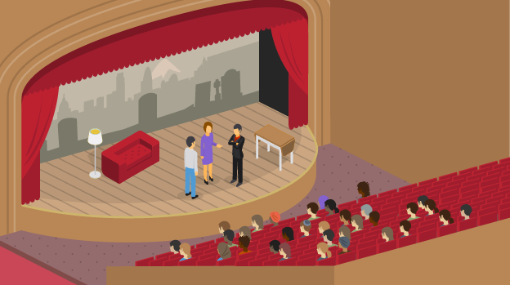
Staging
Task: Write the information and draw the diagram (on the right) in your book
Proscenium Arch
The frame that surrounds an end-on stage, separating it from the audience, often with a curtain that can be lowered from above or curtains that can be closed from the sides behind it.
Apron
An extension of the stage that projects beyond the proscenium arch, over the orchestra pit, and into the auditorium where the audience are sitting.
Stage
Apron
Audience

Slide 7
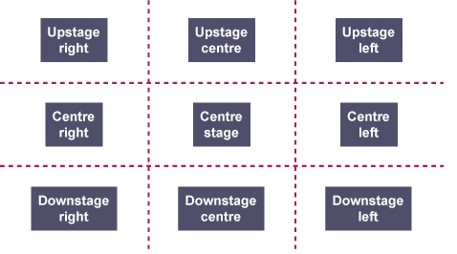
Areas of the Stage
Task: Write the information and draw the diagram in your book
The nine areas of the stage are used to help keep track of where performers and items of set are positioned during rehearsal and performance.
They are from the perspective of the performer – not the audience!
Audience

Slide 8
Exploring A Text
TASK: Write the title and copy all the information below into your book
Dracula is a Gothic novel written by Bram Stoker in 1897 which introduced the famous fictional character of Count Dracula and inspired subsequent vampire fantasy.
The novel has been adapted into numerous films and theatrical productions including plays, opera and ballet.
The novel tells the story of Dracula’s attempt to move from Transylvania to England so that he may find new blood and spread the undead curse, and of the battle between Dracula and a small group of people led by Professor Van Helsing.

Slide 9
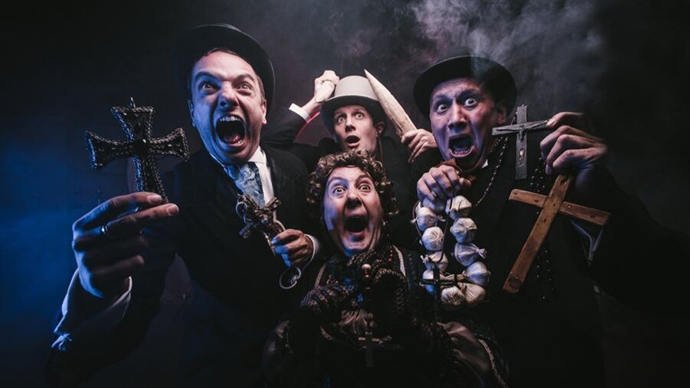
Look carefully at the performers and design elements in this tableau.
Label the copy in your book with written notes describing in detail the physical skills you can see the performers using, the costume they are wearing, the props they are holding and the mood and atmosphere created by the lighting and smoke.
What might these things tell the audience about the play?
Facial Expressions
Posture
Levels
Costume
Props
Lighting
Mood & Atmosphere

Slide 10
TASK: Read the Prologue below and complete the questions on the next page
PROLOGUE
The lights rise. Dracula enters and speaks to the audience.
Dracula For centuries I have walked my world alone. In fierce joy, but
in weariness too. The weariness of solitude. For so long I have
yearned for a companion to share with me this world, this
eternity. And I shall walk alone no more. One shall walk beside
me. One shall become my companion. Here, beneath this sky
lit by its numberless stars, we shall stand together, and gaze
towards the black shadows of the mountains. And we shall be
filled with hunger and silent longing, and the moon shall rise,
and we shall be wolves running, with the horizons rolling
endlessly beneath our feet.
Dracula goes.

Slide 11
TASKS: (Write your responses in your exercise book)
Look up the word ‘prologue’ online or in a dictionary and write the meaning of it in your book.
Write a list of all the things you already know about the character of Dracula – preconceptions such as ‘vampire’, ‘drinks blood’, ‘scary’, etc.
How do you think an audience might feel when they see the character of Dracula walk on stage and speak to them at the start of the play?
Write a description of how the character of Dracula feels and what he wants, based on what he says in the prologue.
Are you surprised by anything Dracula says in the Prologue?
There are lots of films and stories about Dracula, but few portray him as lonely and weary. Why do you think the Playwright makes Dracula express these feelings at the start of the play?
Does this affect the way the audience feels about Dracula?

Slide 12
Scene 2: Jonathan & Mr Hawkins
Read the scene between Jonathan and Mr Hawkins up to when Jonathan says “A great adventure” at the bottom of the page.
Circle, highlight or underline the things we learn about the characters of Jonathan, Mr Hawkins and Dracula.
Annotate the script with detailed written notes about these things and what we can infer about the characters.
Think about how you would use your physical and vocal skills to create these two contrasting characters.
Write two copies of the character profile opposite in your book. Begin to fill them both in with what you know about the characters of Jonathan and Mr Hawkins so far, and the choices you would make for using your physical and vocal skills as a performer.
Character Profile
Name:
Age:
Relationships:
Personality:
Physical Skills:
Stance:
Posture:
Gesture:
Facial Expression:
Gait:
Vocal Skills:
Accent:
Pitch:
Pace:
Volume:
Tone:

Slide 13
Jonathan Harker enters carrying a briefcase. He puts this down and speaks to the audience.
Jonathan It began when I was working as an assistant lawyer in the offices of Mr Hawkins, the solicitor. And it was in connection with with that work, and from Mr Hawkins’s own lips, that I first heard the name of Dracula.
Mr Hawkins enters, carrying a file of papers. He speaks to Jonathan.
Mr Hawkins He lives in Eastern Europe. A small country called Transylvania. Ever heard of it?
Jonathan (Turning to Mr Hawkins.) No, I can’t say that I have.
Mr Hawkins Neither had I. Anyway, this Dracula fellow lives there. An aristocrat. Old family. And he wants to move to England. Fallen in love with the place. All from books, mind. Never been here. (pause) Where was I?
Jonathan You were telling me about Mr Dracula.
Mr Hawkins Count… Count Dracula, my boy. These European chaps can be very touchy about their ancestry and titles. Remember that when you meet him.
Jonathan I’m to meet him?
Mr Hawkins Yes. That’s what I’m coming to. An agent of his called Mr Renfield, strange fellow, brought me a letter from the Count stating that he wished to move to England and wanted a reliable firm to find a place for him. Money no object. How’s that, eh?
Jonathan Your reputation’s travelled far indeed, Mr Hawkins.
Mr Hawkins And so shall you, Jonathan. All the way to Transylvania!
Jonathan What? I’m to go there?
Mr Hawkins Yes! I think I’ve found the kind of place Count Dracula is looking for. A bit of a ruin, really, but that’s what he asked for. Something old and spacious and remote. You’re to travel to his home with all the details and documents. I’ve written to the Count and told him so. (He hands the file to Jonathan.) Everything’s in there – specifications, deeds and a photograph of the property – and contracts for him to sign.
Jonathan When shall I leave?
Mr Hawkins The sooner you go, the sooner you’ll be there, and the sooner back with everything signed and sealed. Do well in this and I’ll make you partner. You’ll be a married man soon, and I need someone to run the business with me.
Jonathan (Deeply grateful) Thank you, Mr Hawkins.
Mr Hawkins We’ll talk further when you get back. (He turns to go, stops and turns back.) It’s a great opportunity for you, my boy. And a great adventure!
Mr Hawkins goes. Jonathan puts the file in his briefcase and as he does so he speaks to the audience.
Jonathan A great adventure.

Slide 14
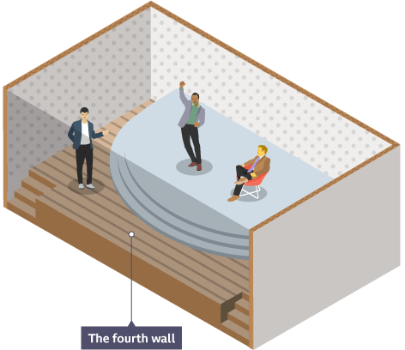
There was only one character in the first scene (Prologue).
This is called a monologue.
In the second scene there are two characters. This is called a duologue. The words spoken by two are more characters is called dialogue.
The character of Dracula was telling his story directly to the audience.
This is called narration.
The narrator ‘breaks the fourth wall’ when they directly address the audience.
At the start of the second scene, Jonathan is narrating his story to the audience and when Mr Hawkins enters
a flashback begins
The audience know that Dracula is a vampire, but the characters in this scene do not. This is called dramatic irony.
Write on your script where the monologue, duologue and flashback begin.

Slide 15
Key Words
TASK: Write these in your book
Monologue | When one solitary character speaks to the audience and shares their feelings or point of view
Narrator | The teller of a story who describes the events of the plot. A character within the story or separate to the story
The Fourth Wall | An imaginary wall between the audience and the performers to help establish the illusion of reality
Duologue | A scene between two characters
Dialogue | Dialogue is when more two or more characters are speaking to each other. The words they say.
Contrast | The use of opposites in juxtaposition. Placing two or more characters together to create meaning for an audience
Dramatic Irony | When the audience knows something that the characters don’t
Flashback | A scene enacting something that happened in the past; the enactment of a character's memory of a past event.

Slide 16
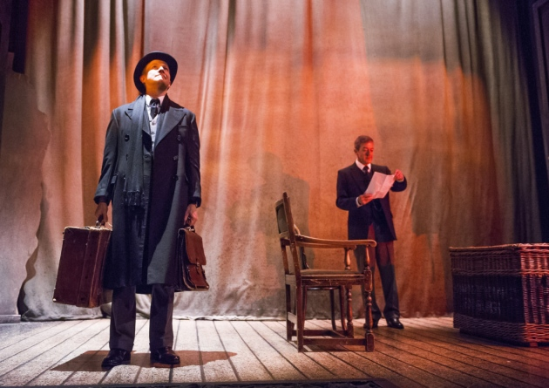
Read the scene between Jonathan and The Landlady up to when Jonathan says “I never saw it again”.
The Landlady tells Jonathan “You speak good German”, but they are both speaking English. What does this suggest?
Circle, highlight or underline the things we learn about the characters of Jonathan and The landlady.
Annotate the script with detailed written notes about these things and what we can infer about the characters.
Think about how you would use your physical and vocal skills to create these two contrasting characters.
Write a character profile for The Landlady in your book, and add anything else you have learned about Jonathan to the character profile you began for him on the previous scene.
In pairs, read/act out scene using vocal and physical skills to create contrast between the two characters.
If the characters of Mr Hawkins and The Landlady were played by the same performer this would be an example of multi-roling.
The location of the scenes change from Mr Hawkins’ office in England to the Landlady’s hotel in Eastern Europe. This transition happens while Jonathan narrates to the audience.
The Landlady gives Jonathan a crucifix. This prop has symbolic meaning.
A tableau or slow motion could mark the moment when the Landlady reacts to the mention of Castle Dracula
Try performing the characters to create comedy?
Try creating tension whenever Dracula is mentioned – Da-da-DAAA!!!
Dramatic irony of audience knowing what the characters do not.

Slide 17
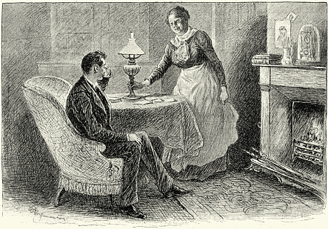
Scene 2: Jonathan & The Landlady
Jonathan puts the file in his briefcase and as he does so he speaks to the audience.
Jonathan I left the next week, took the boat from Calais, went on to Paris, travelled by train to Munich, then onward to Budapest. From there, my journey was by coach, along remote roads, through the mountains, until I arrived at the town of Bistritz, and the hotel where I was to stay before setting out on the final stage of my journey.
The Landlady enters and approaches Jonathan. She speaks with an Eastern European accent.
Landlady English?
Jonathan Yes, that’s right.
Landlady It’s a long way you’ve come. England is far from here.
Jonathan It is. Very far.
Landlady You speak good German.
Jonathan Thank you.
Landlady A good job. There’s no one speaks English here. How long will you stay?
Jonathan Just the one night. I have to go on, tomorrow, through the Borgo Pass. Is there a coach that will take me?
Landlady Yes, there is a coach. It leaves here at four tomorrow afternoon, to Bukovina. Is that where you’re going?
Jonathan No. I only wish to go as far as the Borgo Pass.
Landlady But there’s nothing there.
Jonathan I was told there’s a road that leads to the Castle Dracula.
Landlady (She starts a little.) Castle Dracula?
Jonathan Yes. That’s where I’m going. You know it?
Landlady I know it.
Jonathan And there is a road - ?
Landlady A track. It is not easy to walk.
Jonathan Is it far, though? To the castle?
Landlady (Hesitantly) No…
Jonathan Then I’m sure I’ll manage –
Landlady But the pass is many hours away. It will be dark when you get there.
Jonathan I don’t mind.
Landlady If I’m permitted to ask, why do you go to Castle Dracula?
Jonathan I have business with the count.

Slide 18
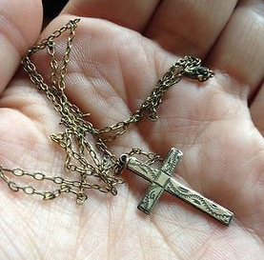
Landlady Business. Must you go there tomorrow?
Jonathan Yes, I must.
Landlady Stay here. One night is such a short time. Our town is beautiful. Stay a little longer, two nights. Go the day after tomorrow.
Jonathan I wish I could. Your town does indeed look very beautiful. But my business is quite pressing. Perhaps when I come back –
Landlady Do you know what tomorrow is?
Jonathan It’s the … fourth of May –
Landlady St. George’s Eve. On that day, and on that night, the evil things of the world have sway. They rise, they walk abroad, they are strong in their power. And that place to which you are going – (She stops.)
Jonathan What of it?
Landlady It is old. Many dead lie in its roots. It has eaten much blood.
Jonathan Look, I … I’m afraid I don’t believe in such things…
Landlady No, not in your land perhaps. You have no need. But here there is need. It is not your land. It is ours, and here such things are real.
Jonathan (Turns and speaks to the audience.) Despite her obvious concern, I insisted I must travel on the next day. And seeing my determination, she fell silent, and showed me to my room. I passed a quiet night, and a pleasant morning, and she spoke no more of her fears, until the carriage arrived and I prepared to take my leave.
Landlady (Speaking to Jonathan.) You are certain about going? You are decided?
Jonathan Yes, I am.
Landlady Then take this.
Jonathan She takes a small crucifix on a chain from her pocket and offers it to Jonathan.
Landlady It is a cross, the sign of Our Lord and Saviour.
Jonathan Really, I couldn’t –
Landlady Please. Take it. For your safety. It will protect you. (Making to put the cross around Jonathan’s neck.)
Jonathan (Sharply) No! I mean… (Changing his tone) Yes, I will take it, thank you…you’re very kind… (He takes the crucifix from her.)
Landlady Keep it with you at all times.
Jonathan I will.
Landlady And may God and His Holy Mother be with you, and keep you from evil. (She turns and goes.)
Jonathan (Speaking to the audience.) I placed the crucifix in my pocket, and forgot about it. And I must have lost it, for I never saw it again. (He puts the crucifix in his pocket and picks up his briefcase.)

Slide 19
Key Words
TASK: Write these in your book
Multi-roling | When a performer plays more than one character onstage. The differences in character are marked by changing physical and vocal skills but the audience can clearly see that the same performer has taken on more than one role.
Symbol | Something which stands for, or represents something else. Symbols are often used in drama to deepen its meaning and remind the audience of themes or issues. A prop often has a particular significance that an audience will instantly recognise when used symbolically in the work.
Transition | A change from one scene or character to another.
Marking the Moment | A way of highlighting the most important moment in a scene in order to draw the audience’s attention to its significance. There are various ways of marking the moment such as using a tableau to freeze the action or using slow-motion movement to fix the moment in the minds of the audience and ensure its significance is not lost.

Slide 20
Plot: The sequence of events in a play (the story)
TASK: Copy this part of the plot into your book
Jonathan Harker, a young English lawyer, travels to Castle Dracula in the Eastern European country of Transylvania to conclude a property transaction with a nobleman named Count Dracula. As Harker wends his way through the picturesque countryside, a local Landlady warns him about his destination, giving him a crucifix as a charm against evil.
Frightened but no less determined, Harker meets the count’s carriage as planned. The journey to the castle is harrowing, with howling wolves and Jonathan is nearly attacked along the way.

