Slide 1
Parents' On-line Safety Presentation 2022

Slide 2
Notes:
Lots of positives. Safety tool for you. Useful for learning etc. We live in a world where teenage tech isn’t going away. Peer pressure.

Slide 3
Source: Ofcom children-media-use-attitudes-2022-report.pdf
Notes:
Now I’m going to talk to you about all the issues..

Slide 4
Notes:
In 2021 Ofsted published a review of sexual abuse in school which (rightly) got a lot of media attention.

Slide 5
Notes:
One of the factors that is considered to have contributed to the ‘normalisation’ of sexual abuse is the sharing of and requesting nude images on line. Not new – we’ve been dealing with this for several years – shocking that some of our young people consider it completely normal to receive random genitalia shots and their parents have no idea.

Slide 6
Notes:
High profile tragic case of Molly Russell has been in the headlines. What seems clear from the inquest is that Molly’s SM activity was a significant factor in her death. Realised from shoes/ on my Instagram/twitter account. What happens if you start typing in I’m depressed/self harm/suicide etc. When you think of the amount of time that young people spend on their phone and imagine being bombarded with that – it quickly normalises it. Go back to

Slide 7
Source: Ofcom children-media-use-attitudes-2022-report.pdf
Notes:
If we go back to the data here – it seems unlikely on the basis what is reported here that young people likely to identify the forces (often dark ones) at work on them.

Slide 9
Notes:
Do you know what sites your children are accessing? Insta, tik tok and Snapchat 13. Information sharing. What’s app your children are playing? And who with? Any game in which they can connect with other people is potentially a threat. One of the things we tell all our students over and over again is that people might not be who they say they are. (examples)

Slide 10
https://youtu.be/z2T-Rh838GA
Notes:
Likes. Our little girls

Slide 11
Notes:
Reverse of the norm – they know more than us so we have to work hard to keep up. And it is hard! Peer pressure to have phones/be online/create content /respond to content etc We have to talk to them. Ask them to show us. We need to have a non-punitive forum for making sure that we keep up with them.

Slide 12
Notes:
Be up front – address it head on now while they are still young enough and before the hormones kick in

Slide 13
Notes:
Have the tech in a busy part of the house

Slide 14
If you have concerns:
Screenshot the conversation/dialogue or take a picture of it with your phone.
Let us know.
Notes:
Most tip offs come from parents/students

Slide 15
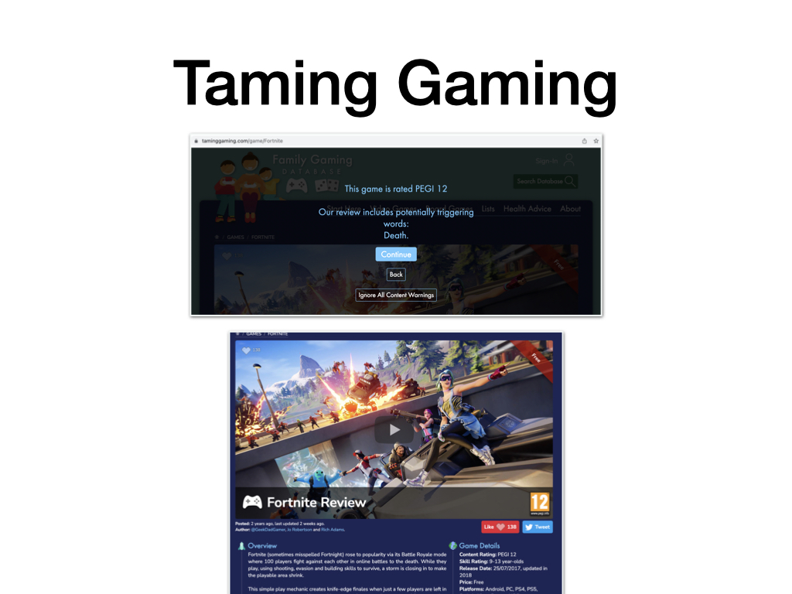
Notes:
Type in the name of the game and it will tell you what you need to know/rating/ risks
But nothing beats sitting with your child while they play

Slide 17
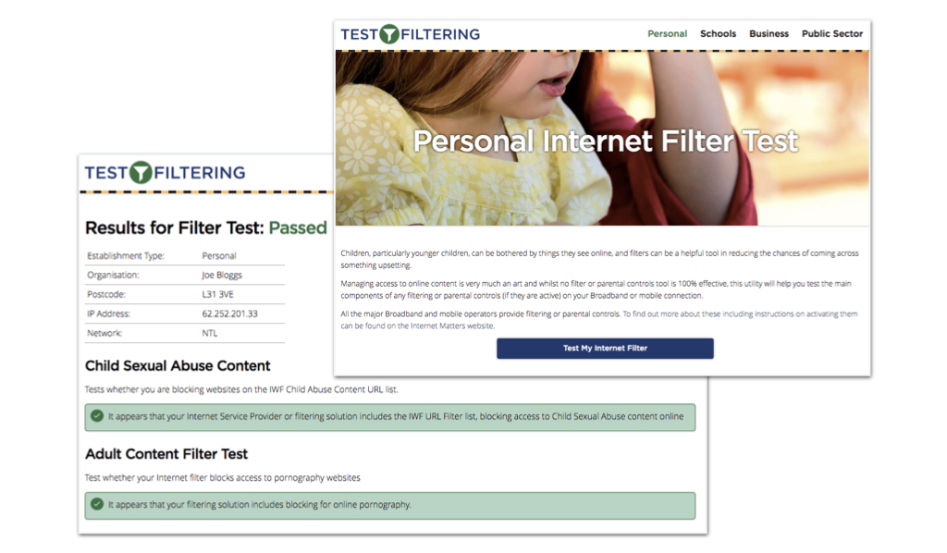
Test your home filtering
http://testfiltering.com/personal/

Slide 18
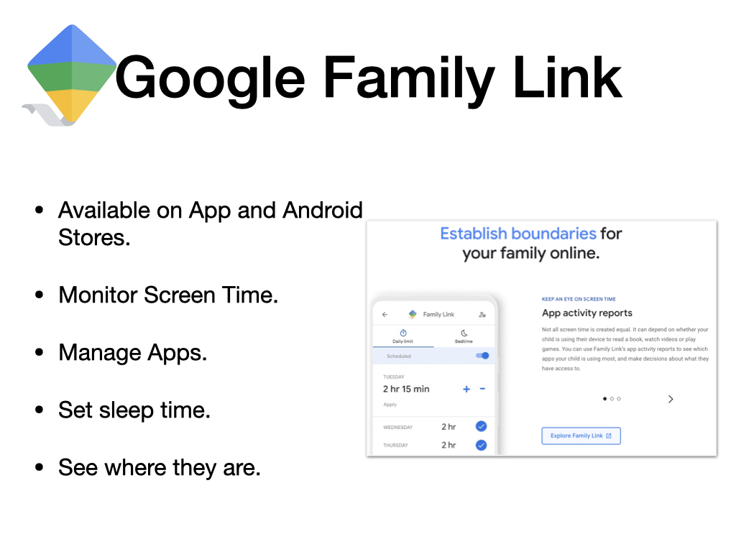

Slide 20
Support for you
You can always speak to:
CEOP
NSPCC
School
Or for more general information you can visit these sites:
The NSPCC (https://www.nspcc.org.uk/keeping-children-safe/online-safety/social-media/chat-apps/)
UK Safer Internet Centre (https://www.saferinternet.org.uk/)
Internet Matters (https://www.internetmatters.org/)
The Parent Zone (https://parentzone.org.uk/home)

Slide 21
Supporting each other…
Please work with us to educate and protect our young people.
Notes:
The phone call

