Slide 1
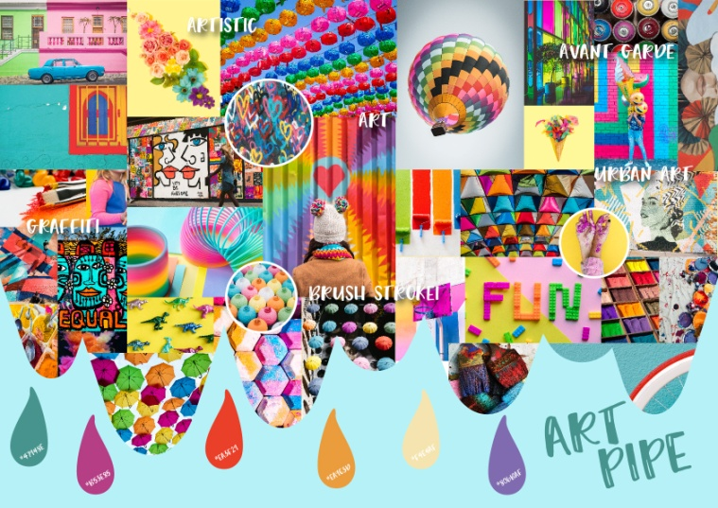
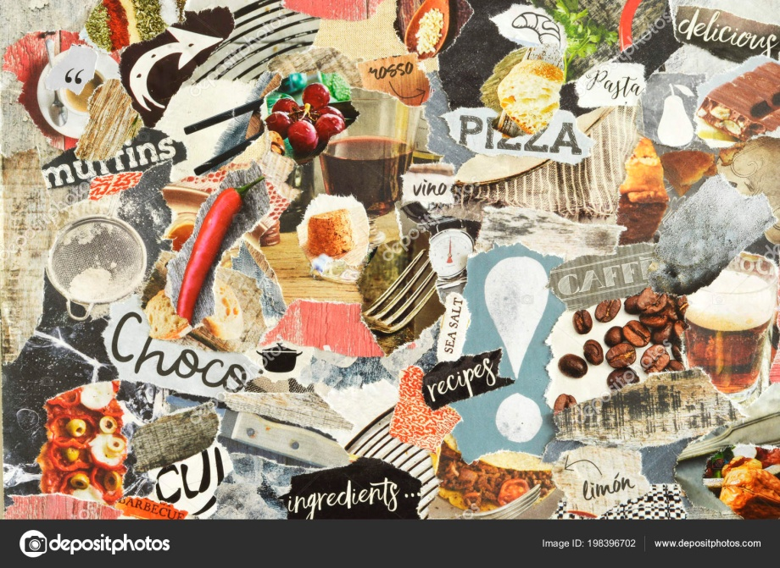
Task 1-
To create a mood board of images linked to the theme of ‘Sweet Treats’.
You could do this on a PP slide or by hand in your book.
Helping hand- find 2 images of each of the following- biscuits, sweets, cakes, chocolate, ice creams.
Challenge- Create a background or boarder on your sketchbook page.
Extension- Take photos of your ‘Sweet Treats’ over the next week and print and stick into your book.
Success Criteria:
Expected - Title and 10 images.
Above expectation -Title (in a style relevant to the theme), 15+ images and some keywords.
Beyond expected -Title (using illustrations of sweet foods within it somehow), 20+ images, many keywords and some sketched ideas.
Tip- try to find images of actual real life items but also artworks which link to this theme.

Slide 2
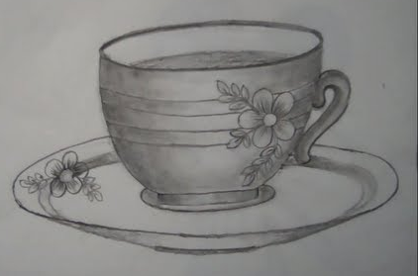
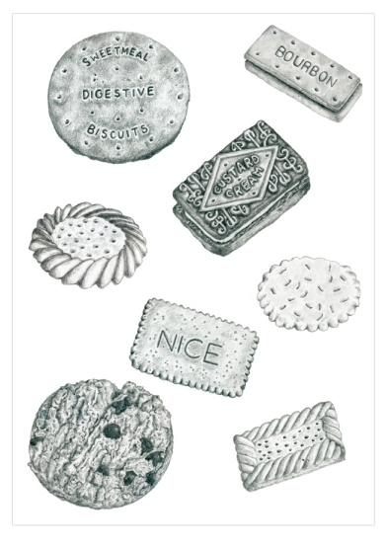
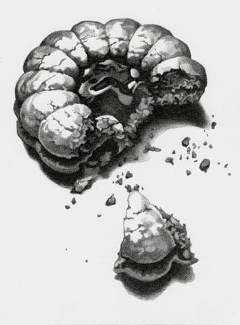
Task 2-
Set up an arrangement / stack of biscuits…
(work from an online image if needed)
…and draw them using pencil. Add a full range of tonal shading.
Helping hand- draw a single biscuit.
Challenge- set up the biscuit/s in a still life with a teacup and saucer and perhaps a teaspoon too.
Extension- Take photos of yourself or a family member either ‘drinking’ from the tea cup or ‘chomping’ on the biscuit- print and stick into student books.
Success Criteria:
Expected - good shape and size with some attempt at tone.
Above expectation - consistent shapes, proportions and details to the still life and there is evidence of tone.
Beyond expected -accurate proportions and use of perspective and a realistic range of tone and textures.
Tip- working from a primary source is important to learn about shape, size, perspective and light.

Slide 3
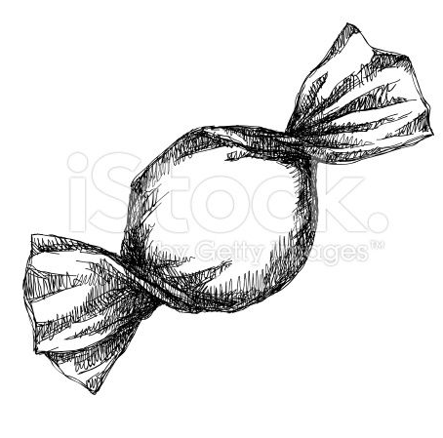
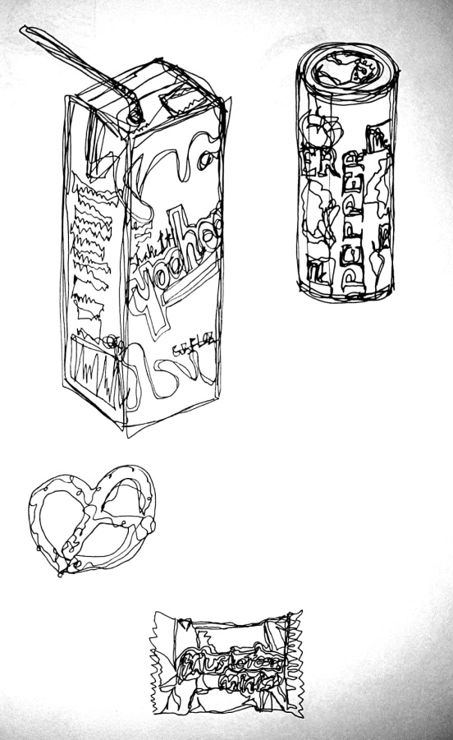
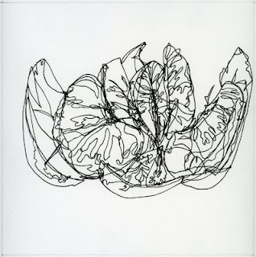
Task 3-
With permission, get out a ‘sweet treat’ which is in a wrapper…
(cake bar, lollipop, chocolate etc work from an online image if needed)
…and create a continuous line drawing of it using pen.
Helping hand- draw a single sweet in a plain wrapper.
Challenge- open the wrapper, peel it back a little and expose part of the food and then draw it.
Extension- create some doodles using your sweet treat within them somehow (look at Victor Nunes’ work).
Success Criteria:
Expected - good shape and size.
Above expectation - consistent shapes, proportions and details to the original and neat use of line.
Beyond expected -accurate shapes, proportions and details to the original and the continuous line is flowing and refined.
Tip- continuous line means whilst drawing you can’t lift up your pen and begin drawing elsewhere. Plus just because it’s a continuous line this doesn’t mean you have to press hard and be stiff in your movement.

Slide 4
Task 4-
Find 4 ‘sweet treat’ brand logos… e.g. Dairy Milk and Skittles.
…Zoom in and crop the logos into interesting sections. Draw and add colour pencil (if you have some).
Helping hand- create one zoomed in logo in the box.
Challenge- you could paint one, collage one, colour pencil one and felt tip one.
Extension- design your own ‘sweet treat’ brand logo (either make it up from scratch or rebrand one of your favourites.
Success Criteria:
Expected - the drawings fills the boxes and colour is applied.
Above expectation - the brand is recognisable from neatly drawn text and applied colour.
Beyond expected - the shapes, sizing, text and colour is identical to the original.
Tip- draw a box 20cm x 20cm and then split this into 4 smaller boxes like the example seen above.

Slide 5
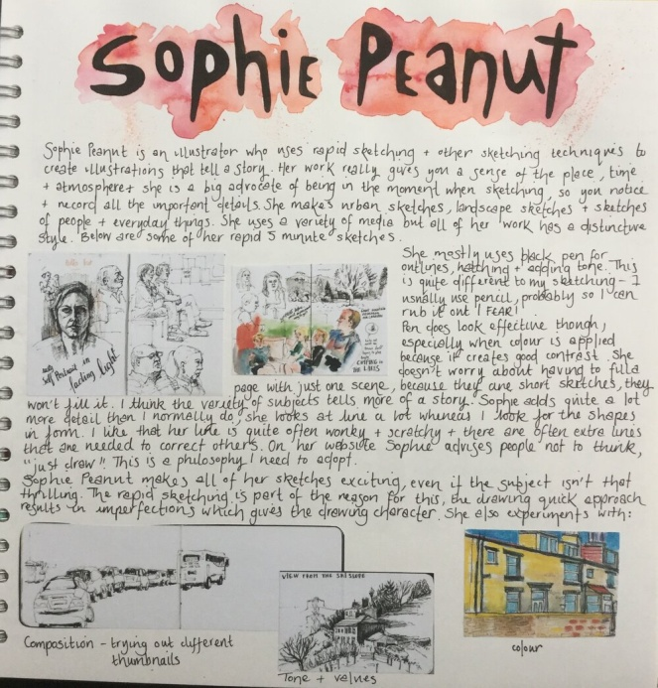
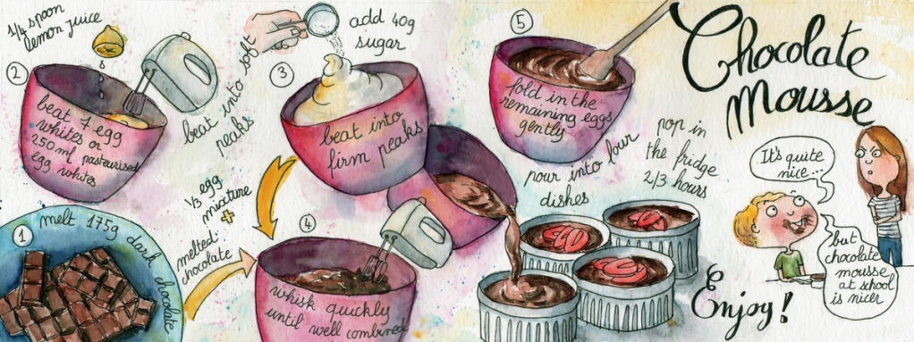
Task 5-
Create an artist research page on Sophie Peanut (Real surname Baxter). An illustrator who likes to tell stories of the world around her.
Helping hand- Where is she from? Did she go to University/What did she study? How does she describe her work?
Challenge- copy an illustrated recipe of hers onto your research page.
Extension- bake a ‘sweet treat’ and take photos as you go ready for next lesson’s task.
Success Criteria:
Expected - name as title, 5 facts about her/her work, images of her work.
Above expectation - interesting font for title, facts written using your own words, images of her work, your opinion of the work and a good layout.
Beyond expected - silver with font style and background/presentation clearly inspired by the artist style; you describe and analyse the work thoroughly yourself and write in your own words.
Tip- the next task is to create your own recipe illustration inspired by hers.

Slide 6
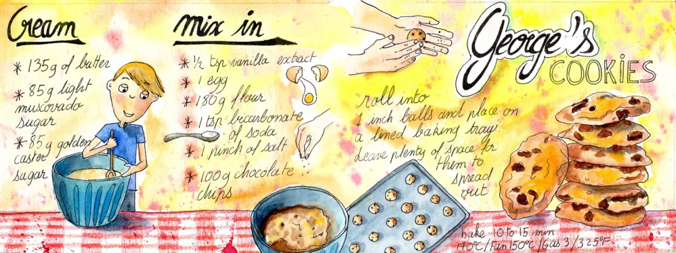
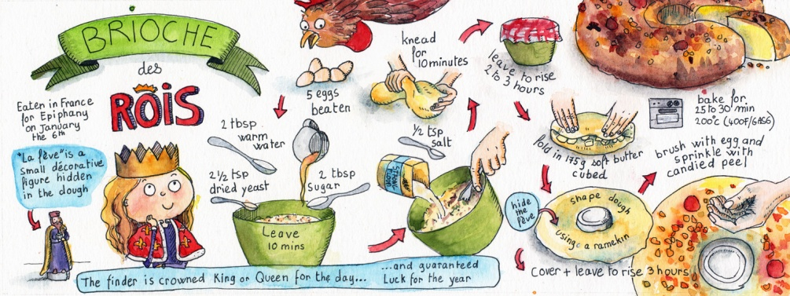
Task 6-
Helping hand- focus on drawing the ingredients and utensils separately within the drawings.
Create a Sophie Peanut inspired illustrated recipe of a ‘sweet treat’ you have made recently (it could be of a savoury meal if you haven’t done any baking). Use pencil and apply watercolour/ colour pencil and pen if you can.
Challenge- include people within your illustrations like Sophie Peanut’s work does.
Tip- style features of her work include:
-overlapping stages of the recipe
-different scenes and sized drawings
-multiple styles of font which ‘flow’ and move amongst the illustrations
-realistic yet ‘subtly’ applied colour
-use of fine black outlines in areas.
Extension- use Sophie Peanut’s style of portraiture to draw the person who is the main ‘chef’ in your family.
Success Criteria:
Expected -there are at least 5 steps and it includes drawings and text.
Above expectation - there is colour, the layout has been thought about and the drawings tell baking/cooking actions as well as show ingredients.
Beyond expected - as silver plus the style of illustration, layout and text is clearly inspired by Sophie Peanuts work.

Slide 7
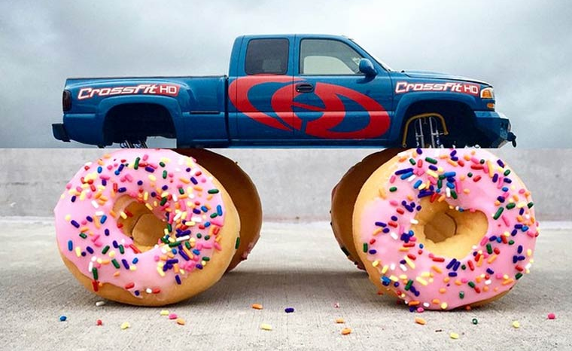
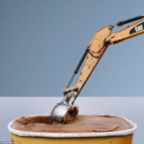
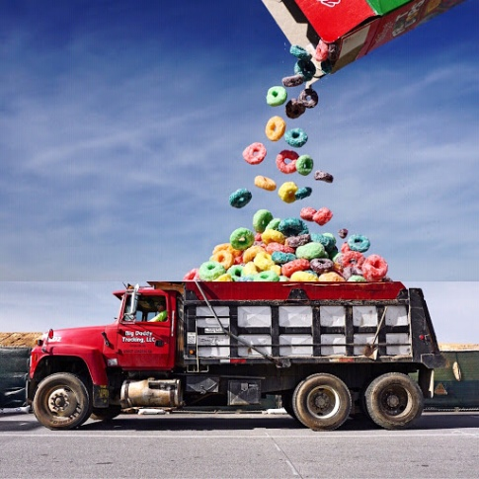
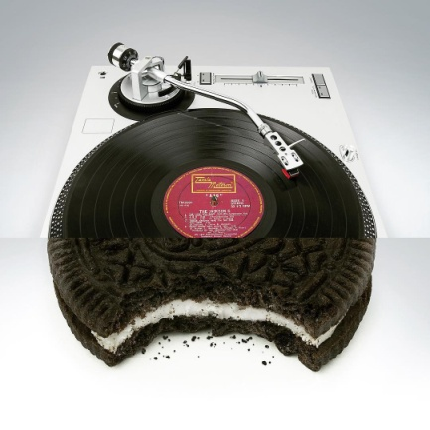
Task 7-
Helping hand- you could use images from online if you find taking the photo yourself too tricky for whatever reason.
Look at the work of Stephen McMennamy’s ‘combo photos / photo mash-ups’ and create one to as many as you like of your own. Photograph your two objects and either by hand or on the computer ‘stitch’ them together.
Challenge- create one/several to represent you/your family members favourite sweet foods/hobbies??
Extension- create a research page on Stephen McMennamy.
Success Criteria:
Expected - the two images ‘mash-up’ generally well together.
Above expectation - the two images align successfully and create a good illusion.
Beyond expected - the alignment is seamless, the image has some humour and the background is consistent to help the illusion further.
Tip- make sure you photograph in good light for more successful imagery.

Slide 8
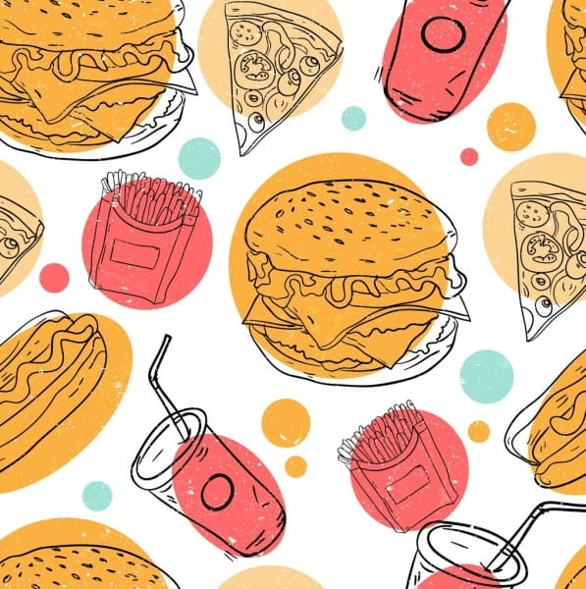
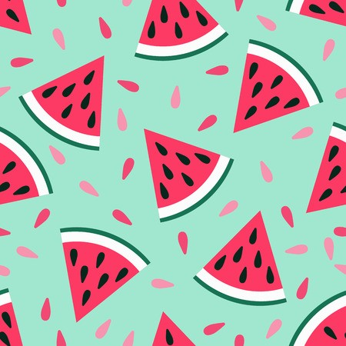
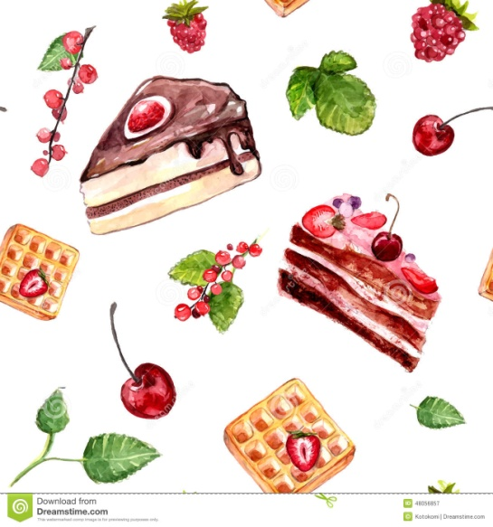
Task 8-
Helping hand- create a sweet treat pattern that doesn’t use the repeat process.
Design a ‘sweet treat’ inspired repeat pattern. Try to include imagery from the work you have created within this project.
Challenge- the pattern could be themed on your Sophie Peanut recipe task or your Stephen McMennamy mash-up photo?
Extension- see extension box on the ‘repeat pattern process’ page…
Success Criteria:
Expected -at least one item from a previous task has been included.
Above expectation - colour has been applied to the objects and the space is filled well. The repeat pattern process has been understood (S and G).
Beyond expected - colour has been applied neatly to the background & objects, the composition is interesting and the drawings are refined.
Tip- use the resource provided and this video to help if needed. https://www.facebook.com/skillshare/videos/1252756628083104/

Slide 9
Tools required:
Tape
A4 piece of paper
Pens, pencils, markers or crayons
A straight edge or ruler
Craft knife or scissors
Optional: Cutting surface
Access to a scanner and printer- see extension box on next page…

Slide 10
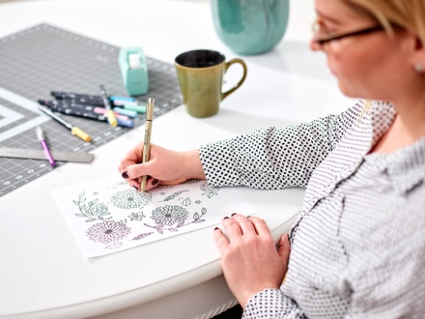
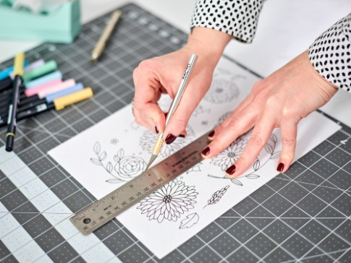
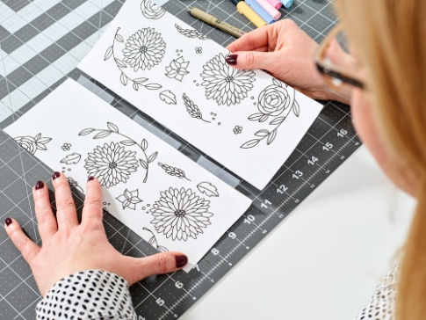
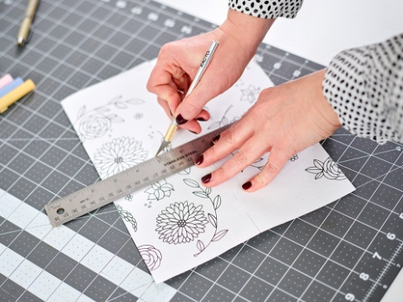
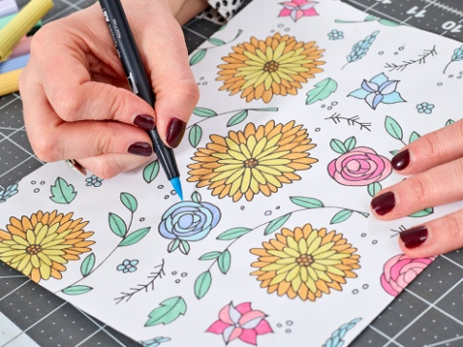
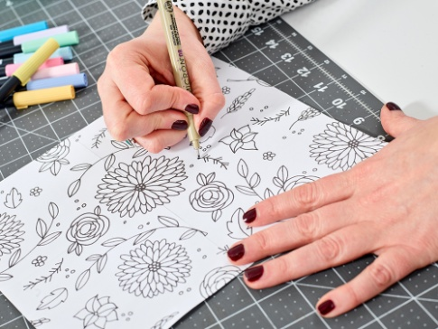
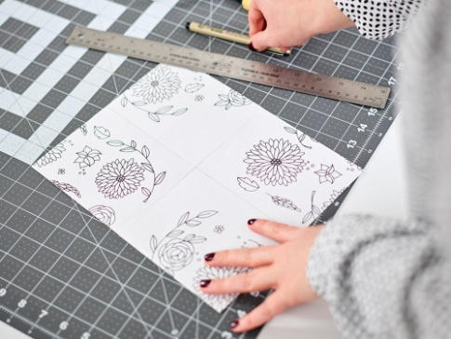
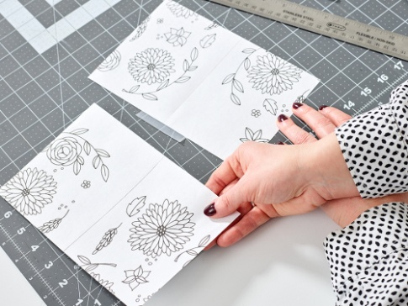
Making a Repeat Pattern
Create your drawing. The key is not to let any of your artwork go off the page—keep it contained!
Cut your paper in half. Once you have your drawing how you’d like it, cut your paper in half lengthwise using a craft knife or scissors.
Swap and tape. Switch the two pieces of paper without rotating them and tape them together on the reverse side.
Cut your paper in half again. Using the same process, cut your paper down the middle width wise.
Colour your artwork. Use markers, pencils or crayons to colour in elements of your pattern if you’d like.
Keep designing. Use your pen or pencil to add to your design so there aren’t any gaps and the spacing of your artwork feels consistent. Just remember to stay off the edges.
Brainstorm. You will now see that you have bisected your art in both directions and there will be an empty area in the middle of your drawing. You’ll need to fill in the blank space.
Swap and tape. Switch these two pieces of paper without rotating them and tape them together on the reverse side.

Slide 11
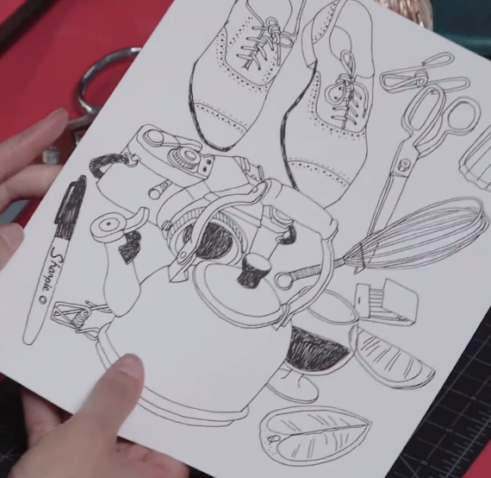
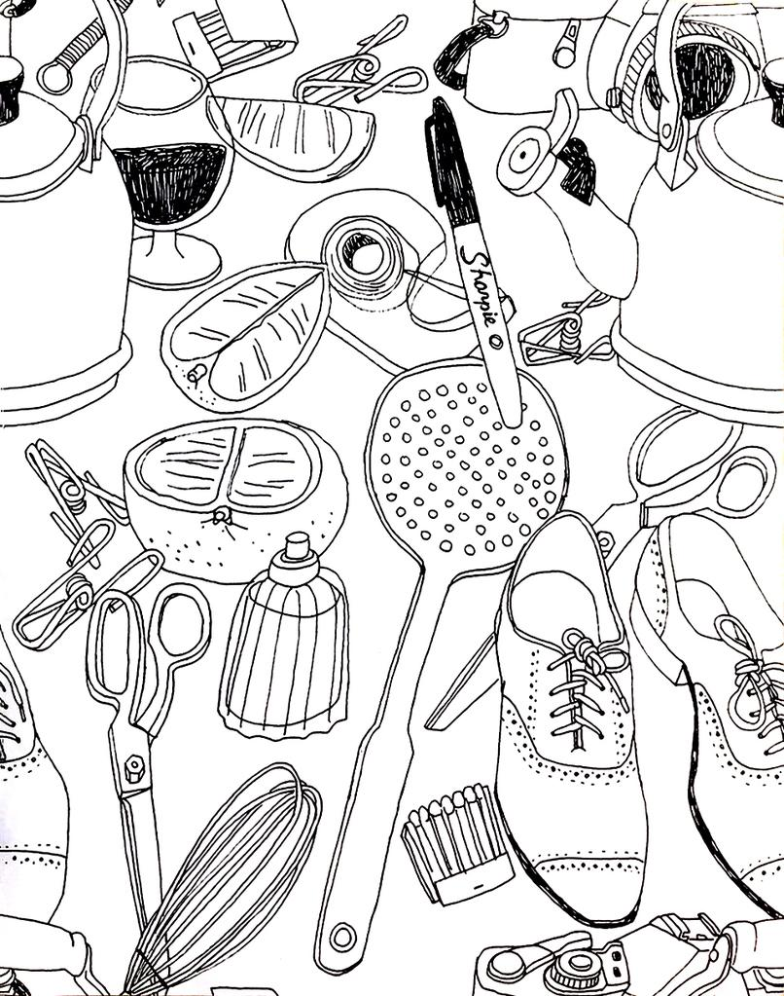
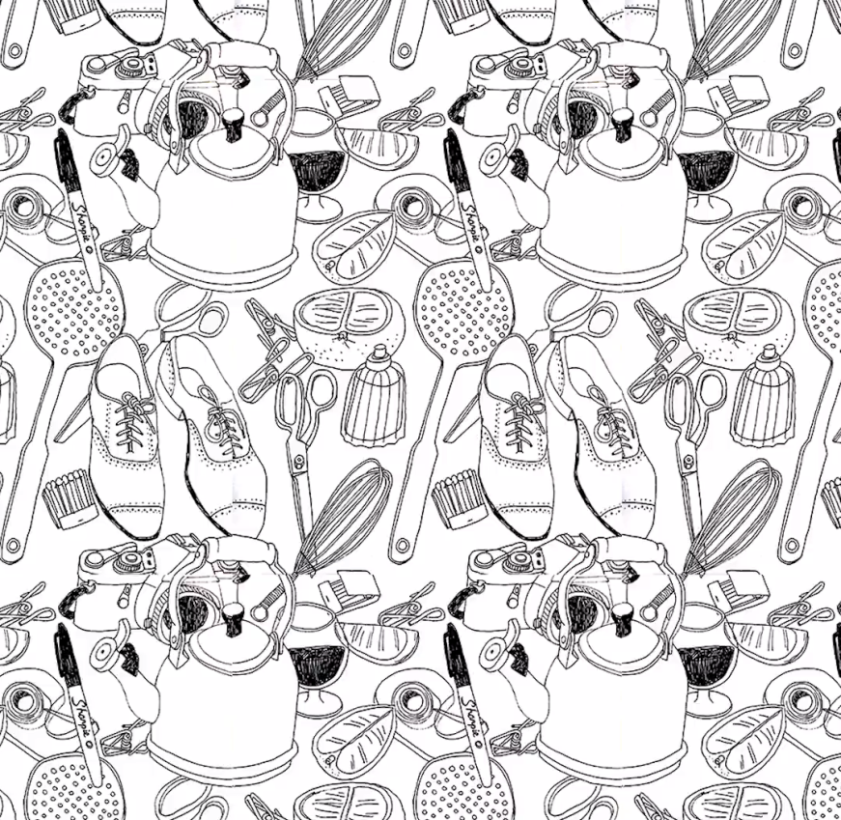
Making a Repeat Pattern
Extension
Now that you have your tile, the possibilities are limitless!
You can photocopy it a minimum of 4 times and assemble it for wallpaper, book covers, posters, or gift wrap.
Maybe you digitize it for your desktop or phone background.
If you don’t have a scanner / photocopier / printer you could photograph it on your phone and use an app like ‘Pic Collage’ to put four copies of it together to reveal the success of your repeat pattern.
Most importantly, have fun with this technique.

