Slide 1
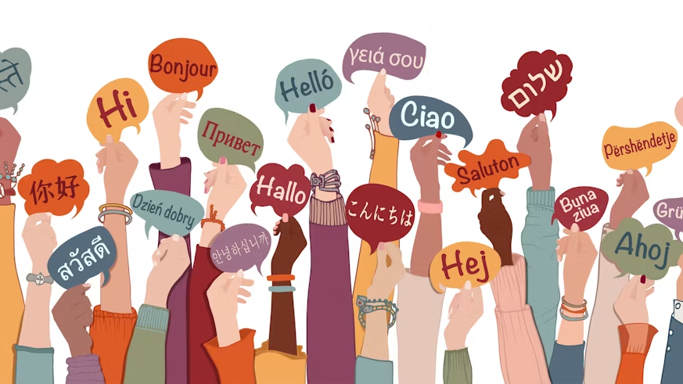
Why take a language at GCSE?
Why take a language at GCSE?

Slide 2
“A different language is a different vision of life” Federico Fellini

Slide 3
Languages can help open doors when we travel the world!

Slide 4
They can be useful in the workplace!

Slide 5
They can help you make friends!
https://youtu.be/6dTN6UWbEKA

Slide 6
But most importantly it helps you build skills that you can use all the time!
It makes you pay more attention to detail
It makes you more accurate
It helps you problem solve
It helps you fail, improve and succeed
It helps you learn about your own language, history, culture
It helps you learn about other people and culture
It helps you learn what the building blocks of languages are so that you can learn more
It is great on holiday
It gives you confidence
It gives you communication skills
It complements any subject at any level: GCSE, A level, Degree, Post Graduate
IT IS FUN!!!

Slide 7
It’s a multilingual world…
Did you know there are 6,912 known living languages in the world?
Test your knowledge, part 1…

Slide 8
It’s a multilingual world…
How many people in the world speak these languages as their mother tongue?
French
Arabic (all varieties)
a) 64,850,000
b) 640,860,000
c) 25,000,000
a) 64,850,000
b) 640,860,000
c) 25,000,000
a) 150,000,000
b) 206,000,000
c) 1,156,000,000
a) 150,000,000
b) 206,000,000
c) 1,156,000,000

Slide 9
It’s a multilingual world…
How many people in the world speak these languages as their mother tongue?
English
Chinese (Mandarin)
a) 309,350,000
b) 55,000,000
c) 187,000,000
a) 309,350,000
b) 55,000,000
c) 187,000,000
a) 1,052,000,000
b) 358,000,000
c) 876,000,000
a) 1,052,000,000
b) 358,000,000
c) 876,000,000
508,000,000 including second language speakers
1,052,000,000 including second language speakers

Slide 10
It’s a multilingual world…
How many people in the world speak these languages as their mother tongue?
Spanish
Hausa
a) 102,000,000
b) 61,700,000
c) 322,300,000
a) 102,000,000
b) 61,700,000
c) 322,300,000
a) 60,000
b) 24,162,000
c) 10,300,000
a) 60,000
b) 24,162,000
c) 10,300,000

Slide 11
It’s a multilingual world…
What have all these languages got in common?
They are all spoken in more than one country and often used as additional languages to communicate across borders

Slide 12
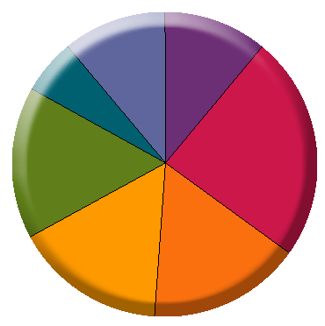
It’s a multilingual world…
Test your knowledge, part 2 - Languages of the European Union
Match the language to the percentage of its native speakers in the EU
Español
All others
Français
Nederlands
11%
11%
Deutsch
Italiano
6%
Español
Deutsch
Italiano
24%
English
16%
Nederlands
All others
16%
16%
Français
English

Slide 13
The GCSE exam
This is made up of 4 different papers: Listening, reading , writing and speaking.
Across the two year course we help prepare you for exam success.
If you have been studying French since Y7 you are completely capable of continuing French to GCSE and beyond.
If you have been studying Spanish since Y7 you are completely capable of continuing Spanish to GCSE and beyond.

Slide 14
Don’t just listen to us!
https://youtu.be/DdqZ7cfZtY4

Slide 15
If you have any questions just come and ask!

