Slide 1
Year 11 GCSE Art Home Learning
Work through the following slides, lesson by lesson.
If you click on a slide that you have done already ( at home or at school) go to the next slide…

Slide 2
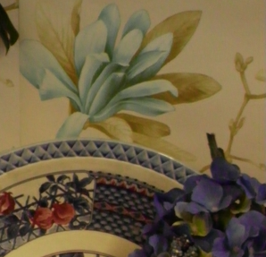
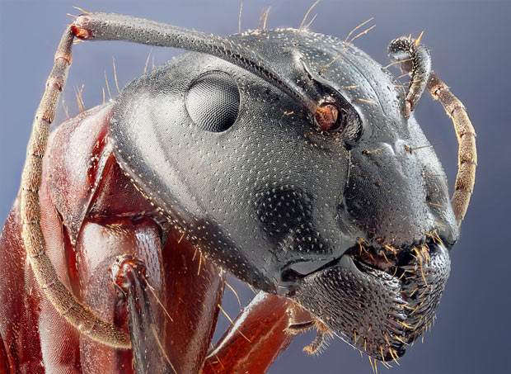
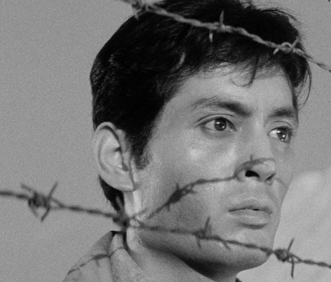
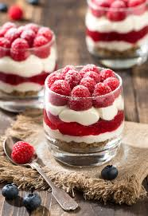
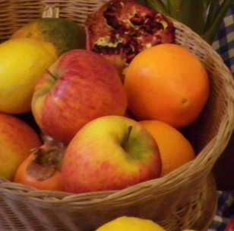
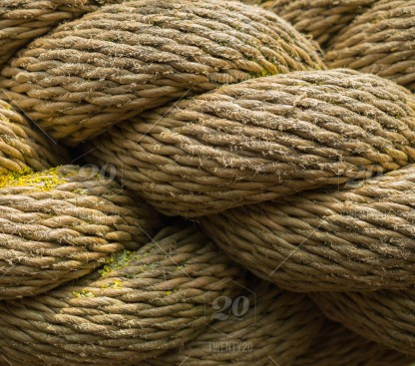
Task one - Close up observation drawings of images linked to your chosen theme. Select three images from the images on this slide. Its up to you to convince us that your chosen image links! If needed to …. print out images
These drawing should take 2 hours
Make drawings of each of your images. Make sure your drawings are at least 12 x 12 cms. You can choose your own media for this task but make sure you challenge yourself

Slide 3
Task two- select a different image (you can choose your own from the internet if you like) use mark making to create a finished drawing.
This drawing should take 2 hours

Slide 4
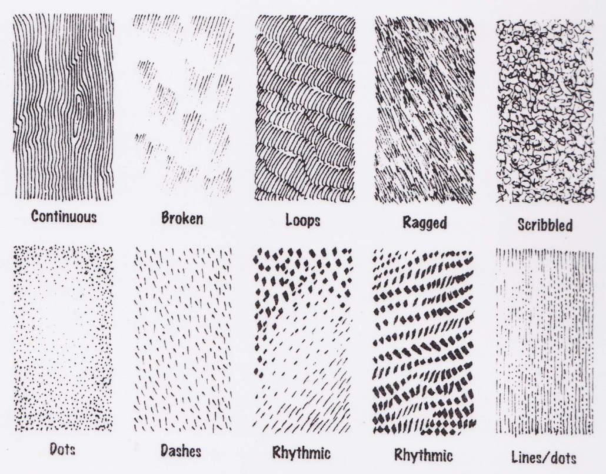
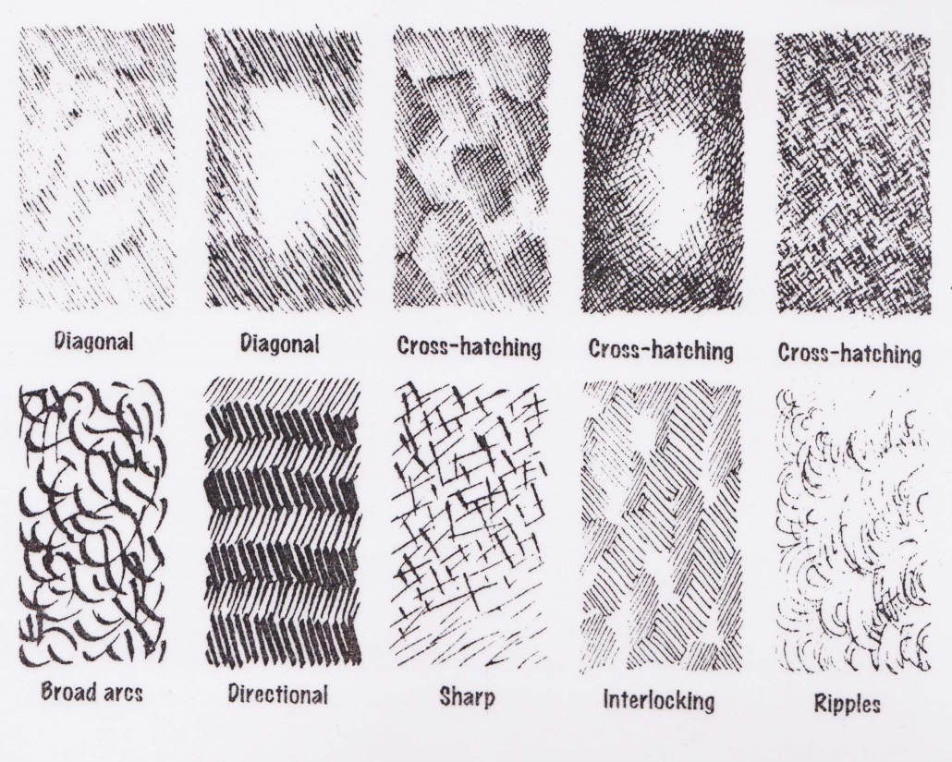
Mark-making
We can use different marks to make tone. The closer the marks are together, the darker the tone is. The further the marks are apart, the lighter the tone.
Mark-making is the expression we use to describe the process of applying pencil to paper.
Controlling and exploring the possibilities of the mark is an important step in developing as an artist.
WHAT IS MARK MAKING?

Slide 5
Task three - select an image (you can choose your own from the internet if you like) use acrylic paint to create a finished art work. Your finished piece should be at least half the size of your page.
This artwork should take 2 hours

